Slide 1

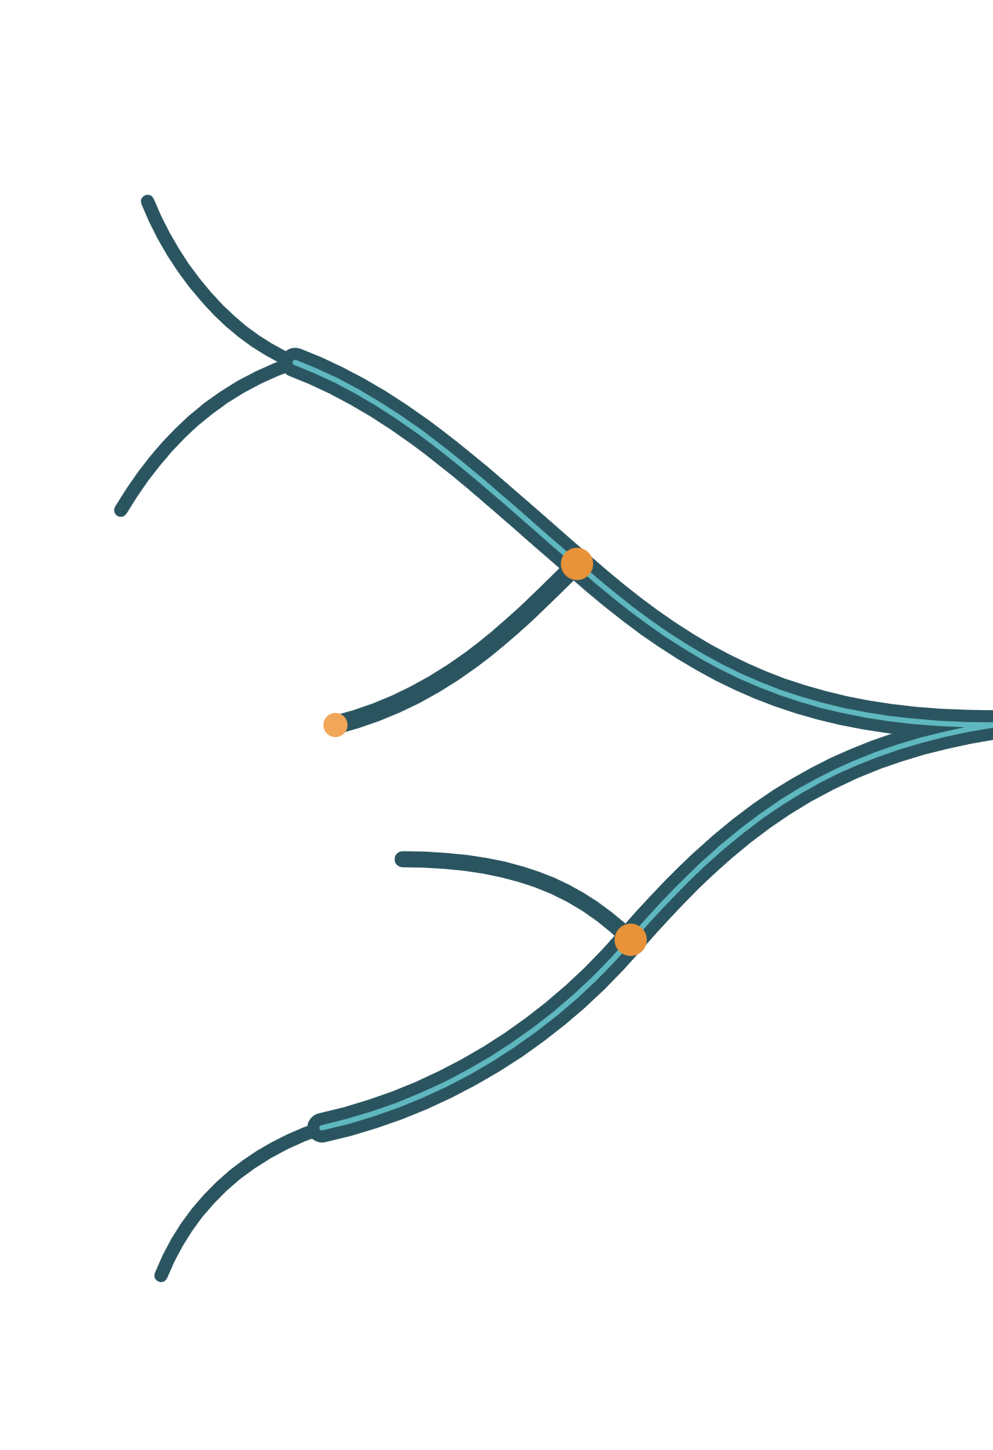
Cholestasis: Beyond Bile Flow
﷽

Slide 2
CHOLESTASIS: BEYOND BILE FLOW
1 / 5
3
2
Pruritus:
4
mechanisms
5
The biopsy
Adult genetic
and patterns
and treatment
Established and
cholestasis
emerging
therapeutics
1
What is
cholestasis
Take Home
Notes:
Transition slide 1 of 5. Same slide repeated between sections; the lit branch marks the topic that starts now. Order: What is cholestasis; The biopsy and patterns; Pruritus: mechanisms and treatment; Adult genetic cholestasis; Established and emerging therapeutics.

Slide 3
Which finding establishes cholestasis?
Isolated ALP elevation
Isolated GGT elevation
Isolated conjugated hyperbilirubinemia
Elevated serum bile acids
EASL DEFINITION
“An impairment of bile formation and/or bile flow which may present with fatigue, pruritus and, in its most overt form, jaundice.”
Early markers: ALP and GGT. Conjugated bilirubin rises later.
Proposed thresholds (debated): ALP >1.5 × ULN and GGT >3 × ULN
Chronic: more than 6 months

Slide 4

Cholestasis is impaired bile formation or flow, not a synonym for obstruction
1 · MAKE
2 · SECRETE
3 · CARRY
4 · RECLAIM
Synthesis
Canalicular export
Ductal flow
Gut and return
Cholesterol → primary bile acids, then conjugation
Small ducts to large ducts; cholangiocytes modify bile
Ileal uptake returns most bile acids to the liver
Bile salts, phospholipid, bilirubin across the canalicular membrane
Fails in: bile acid synthesis defects (rare)
Fails in: BSEP or FIC1 deficiency, drugs, sex steroids, sepsis
Fails in: PBC, PSC, toxic bile (MDR3), stones, strictures, tumour
Not a cause here, but a therapeutic lever
Thompson R, Vilarinho S, Miquel R ... Challenges in the diagnosis and treatment of genetic cholestasis in adults JHEP Reports, 2025; 8
Fuchs et al, J Hepatol 2025;82:134
Notes:
Thompson and colleagues define cholestasis as impaired bile formation or disrupted bile flow through the biliary tree into the small intestine, and note that bile formation itself involves synthesis of constituents, transport across the canalicular membrane, and movement through the biliary tree. This slide lays those stages out in order and adds the fourth stage, ileal reclamation, because it becomes a therapeutic target in Lecture 2. The teaching point for juniors: obstruction is only one way to be cholestatic. A patient can be deeply cholestatic with completely normal ducts on imaging because the failure is at the canalicular membrane. That is why imaging cannot be the last word in this field. For consultants: retention, not jaundice, is the common end point. Many cholangiopathies are anicteric for years. And the same retained bile acid pool injures differently depending on species, compartment, duration, immune milieu and compensatory capacity, not just total concentration ( , section 1.1, drawing on Fuchs 2025). Colour code used throughout: amber marks canalicular secretory failure, green marks ducts (the same green as ducts in the anatomical schematics), teal marks the enterohepatic and therapeutic side. Evidence status: the staging is established physiology. Examples in each box are representative, not exhaustive.

Slide 5
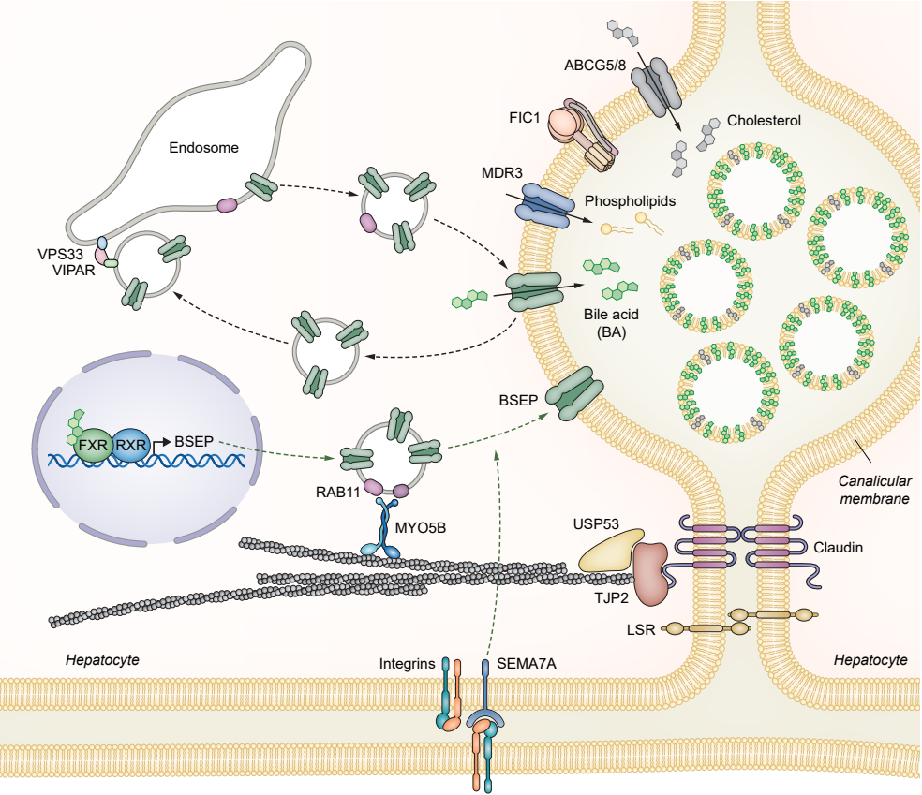
Thompson R, Vilarinho S, Miquel R ... Challenges in the diagnosis and treatment of genetic cholestasis in adults JHEP Reports, 2025; 8

Slide 6
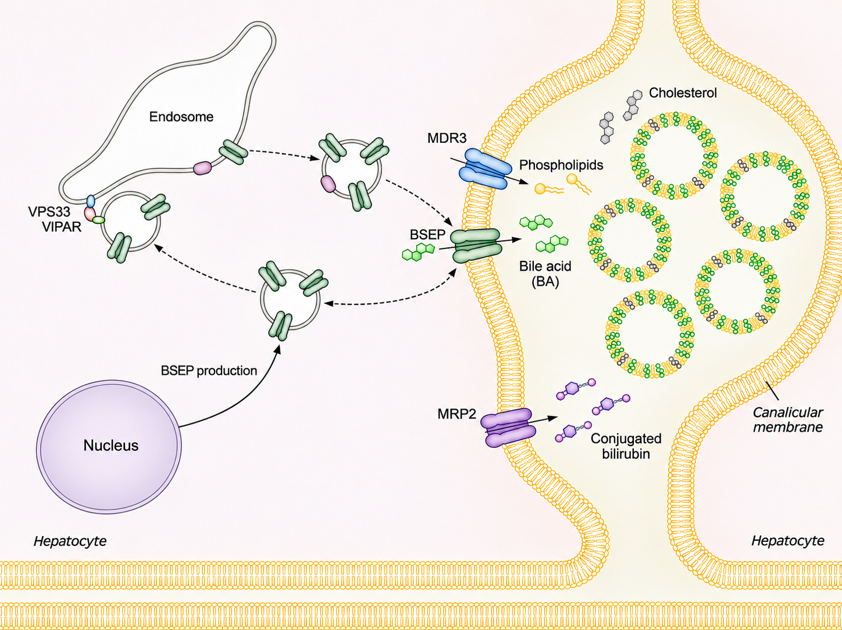
CHOLANGIOPATHY
Bile duct epithelium is the primary site of injury
Usually raised GGT and ALP
Genetic: MDR3 (ABCB4) and rarer genes
PRIMARY CHOLESTASIS
ABCB4
Bile constituents retained inside hepatocytes
Typically normal GGT with high serum bile acids
Genetic: BSEP, FIC1, TJP2, FXR and trafficking defects
ABCB11
Dupin-Johnson Syndrome
Thompson R, Vilarinho S, Miquel R ... Challenges in the diagnosis and treatment of genetic cholestasis in adults JHEP Reports, 2025; 8

Slide 7
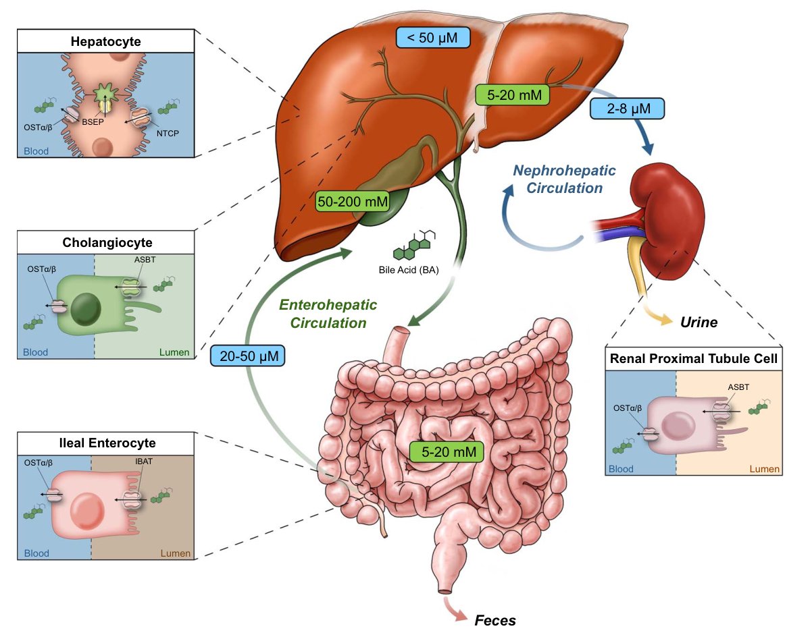
Bile acids circulate: liver, gut, ileum and back
Trauner M, Karpen SJ, Dawson PA. Benefits and challenges to therapeutic targeting of bile acid circulation in cholestatic liver disease. Hepatology. 2025 Oct 1;82(4):855-876
Notes:
Follow one bile acid. The hepatocyte makes primary bile acids from cholesterol, mainly through the classical CYP7A1 pathway, conjugates them and exports them across the canalicular membrane. Canalicular bile salt secretion is an important osmotic driver of bile flow, which is why a bile salt export defect causes cholestasis even with perfectly normal ducts. In the intestine, bile acids form micelles that carry dietary fat and fat-soluble vitamins; microbes chemically modify some of them. Most are actively reabsorbed in the terminal ileum through the apical sodium-dependent bile acid transporter, ASBT, also called IBAT, and return to the liver in portal blood, where NTCP is the main sinusoidal uptake route. New synthesis replaces the small fraction lost in stool. Three compartments matter clinically: the canaliculus, where secretion begins; the duct lumen, where cholangiocytes are exposed to detergent stress; and the ileum, which controls how much bile acid comes back. Each is now a therapeutic target, which is the preview in the dark box. One mechanistic consequence worth stating now: blocking ileal reuptake delivers more bile acid to the colon, which predictably causes diarrhoea. In the linerixibat phase 3 trial, diarrhoea was the most frequent adverse event; details in Lecture 2. I have avoided a precise recycling percentage on the slide; textbooks quote that most of the pool is reclaimed, and that is all the argument needs. Evidence status: established physiology.

Slide 8


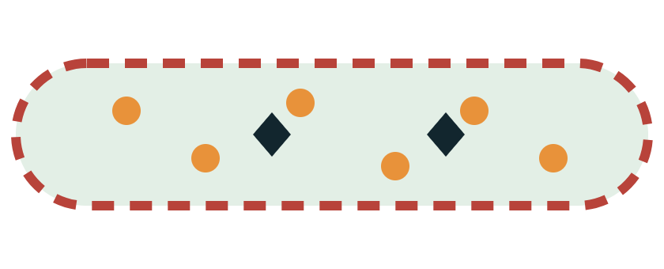
BSEP moves the detergent; MDR3 supplies the protection
Same membrane, different cargo, different injury, different GGT
NORMAL
BSEP FAILURE
MDR3 FAILURE
Bile salts packaged with phosphatidylcholine
Bile salts trapped in the hepatocyte
Free detergent and crystals injure ducts
Mixed micelles protect the duct lining
High serum bile acids; GGT classically low or normal
High GGT; stones, LPAC, biliary fibrosis
Archetypes from severe disease. Partial-function adult alleles blur the GGT rule.
Thompson R, Vilarinho S, Miquel R ... Challenges in the diagnosis and treatment of genetic cholestasis in adults JHEP Reports, 2025; 8
· EASL genetic cholestasis CPG 2024
Notes:
This slide replaces a list of transporters with one mechanistic contrast that explains several clinical observations. Left: normally, bile salts exported by BSEP and phosphatidylcholine supplied by MDR3 form mixed micelles with cholesterol. Phosphatidylcholine increases cholesterol solubility and protects the biliary epithelium from the detergent activity of bile acids (Thompson, MDR3 section). Middle: when BSEP function is severely reduced, bile salts cannot leave the hepatocyte. They accumulate inside, injure the hepatocyte and spill back into blood. Little reaches the ducts, so the duct lining is spared and GGT is classically normal despite high serum bile acids. Thompson describes this low-GGT, high-bile-acid picture for biallelic ABCB11 and NR1H4 defects. Right: when MDR3 function is reduced, bile salts still reach the ducts but without enough phosphatidylcholine to form micelles. Free bile acids injure cholangiocytes, GGT rises, and the reduced capacity to solubilise cholesterol increases the risk of gallstones and low phospholipid-associated cholelithiasis. Thompson adds that Mdr2-deficient mice develop gallstones, periductal fibrosis, strictures and hepatobiliary malignancy. The caution in the grey bar matters for adults. These are archetypes drawn from severe, usually biallelic disease. Adult partial-function and heterozygous alleles produce milder, intermittent and less stereotyped biochemistry. Evidence status: mechanism established; the adult GGT association is probabilistic.

Slide 9
CHOLESTASIS: BEYOND BILE FLOW
3
2
Pruritus:
4
mechanisms
5
The biopsy
Adult genetic
and patterns
and treatment
Established and
cholestasis
emerging
therapeutics
1
What is
cholestasis
Take Home
Notes:
Transition slide 1 of 5. Same slide repeated between sections; the lit branch marks the topic that starts now. Order: What is cholestasis; The biopsy and patterns; Pruritus: mechanisms and treatment; Adult genetic cholestasis; Established and emerging therapeutics.

Slide 10
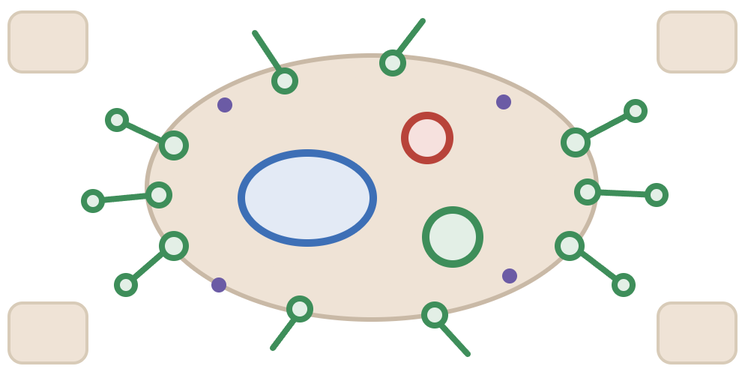
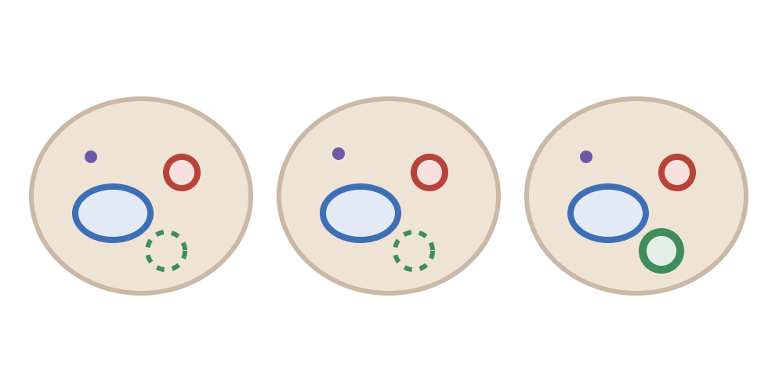
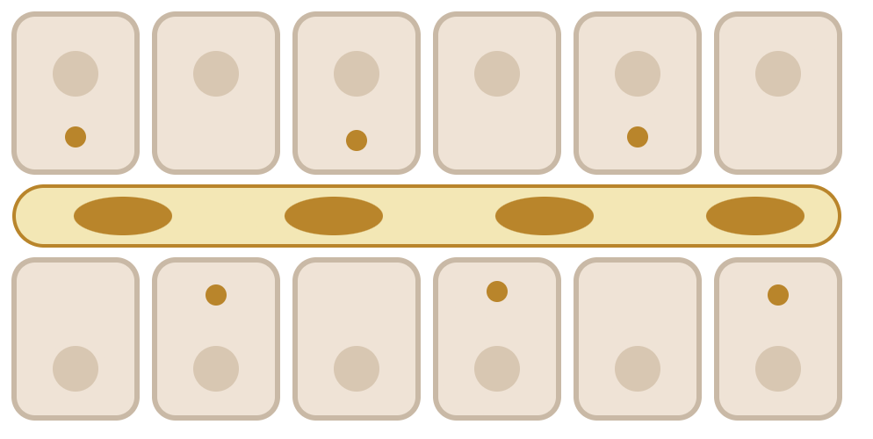
Look for these in the biopsy
Ductular reaction
Ductopenia
Bland cholestasis
A repair response: more ductular profiles at the edge of the portal tract
Native ducts absent in more than half of portal tracts, in an adequate sample
Bile in canaliculi and hepatocytes without duct injury or much inflammation
Look for: irregular ductules at the portal–parenchymal interface (CK7)
Look for: an artery and portal vein with no companion duct (CK7)
Look for: canalicular bile plugs, mainly zone 3, minimal inflammation (H&E)
Not specific for obstruction
Needs about 10 or more portal tracts
Does not name a transporter
Ductopenia and ductular reaction can coexist in the same biopsy
, section 3.2 and Table 2 · Int J Mol Sci 2025;26:7729 · Gastroenterology 2025;168:675 · Original schematics
Notes:
This slide replaces the old "three observations" slide, which had image placeholders. The drawings are original schematics, not histology; add licensed images later if you want them beside the drawings. Colours: artery red, portal vein blue, ducts green, bile amber, inflammatory cells purple, as on the earlier histology slides. Three observations that are often blurred in clinical letters. Ductular reaction is a repair response: irregular ductular profiles at the portal–parenchymal interface, often with oedema, inflammation and stromal expansion. In the drawing, ductules spread from the tract edge into the parenchyma. It occurs in large-duct obstruction, PBC, PSC, drug injury and some hepatitic injuries, so on its own it is not evidence of obstruction. Ductopenia is loss of native interlobular bile ducts. The usual working definition is absence of interlobular ducts in more than half of evaluable portal tracts, and assessment needs an adequate sample; the cites about ten or more adequately represented portal tracts. In the drawing, two of three tracts show an artery and vein without a duct (dashed outline where it should be). Orientation and sampling matter. Causes include PBC, PSC, drug-induced vanishing bile duct syndrome, allograft rejection and graft-versus-host disease. Bland cholestasis is bile in canaliculi and hepatocytes with little inflammation and no duct injury, mainly in zone 3. It points toward secretory dysfunction but does not identify a specific transporter or gene. The dark bar is the pearl: fewer native ducts and many reactive ductules can be present together. A biopsy full of CK7-positive profiles can still be ductopenic. Slide number 23 assumes this follows the four histology insert slides (19 to 22) in the master. Evidence status: established descriptive pathology; the ten-portal-tract threshold is a convention, not a validated cut-off.

Slide 11






Causes of ductopenia in adults
WORKING DEFINITION
Immune cholangiopathy
PBC, small-duct PSC
Drugs
Vanishing bile duct syndrome after drug injury
> 50%
Transplant
Chronic rejection; graft-versus-host disease
Systemic
Sarcoidosis; Hodgkin lymphoma
of portal tracts have no interlobular duct
Counted in an adequate sample
Genetic
ABCB4; ABCC12 (normal GGT); Alagille
Idiopathic
Idiopathic adulthood ductopenia: a diagnosis of exclusion
Thompson R, Vilarinho S, Miquel R ... Challenges in the diagnosis and treatment of genetic cholestasis in adults JHEP Reports, 2025; 8
· Int J Mol Sci 2025;26:7729
Notes:
A differential for ductopenia, for use when duct loss is reported. Immune cholangiopathies, PBC and small-duct PSC, are the commonest. Drug-induced vanishing bile duct syndrome follows a cholestatic drug injury and may persist after withdrawal. After transplantation, chronic rejection and graft-versus-host disease cause duct loss. Systemic causes include sarcoidosis and Hodgkin lymphoma, where vanishing bile duct syndrome can be paraneoplastic. Genetic causes include ABCB4 and, per Thompson, ABCC12, which is notable for duct loss with normal GGT; Alagille syndrome is a paediatric diagnosis that can surface in adults. Idiopathic adulthood ductopenia remains a diagnosis of exclusion, and some such cases may have an undetected genetic basis. The working definition is absence of interlobular ducts in more than half of portal tracts in an adequate sample. Evidence status: established descriptive pathology.

Slide 12

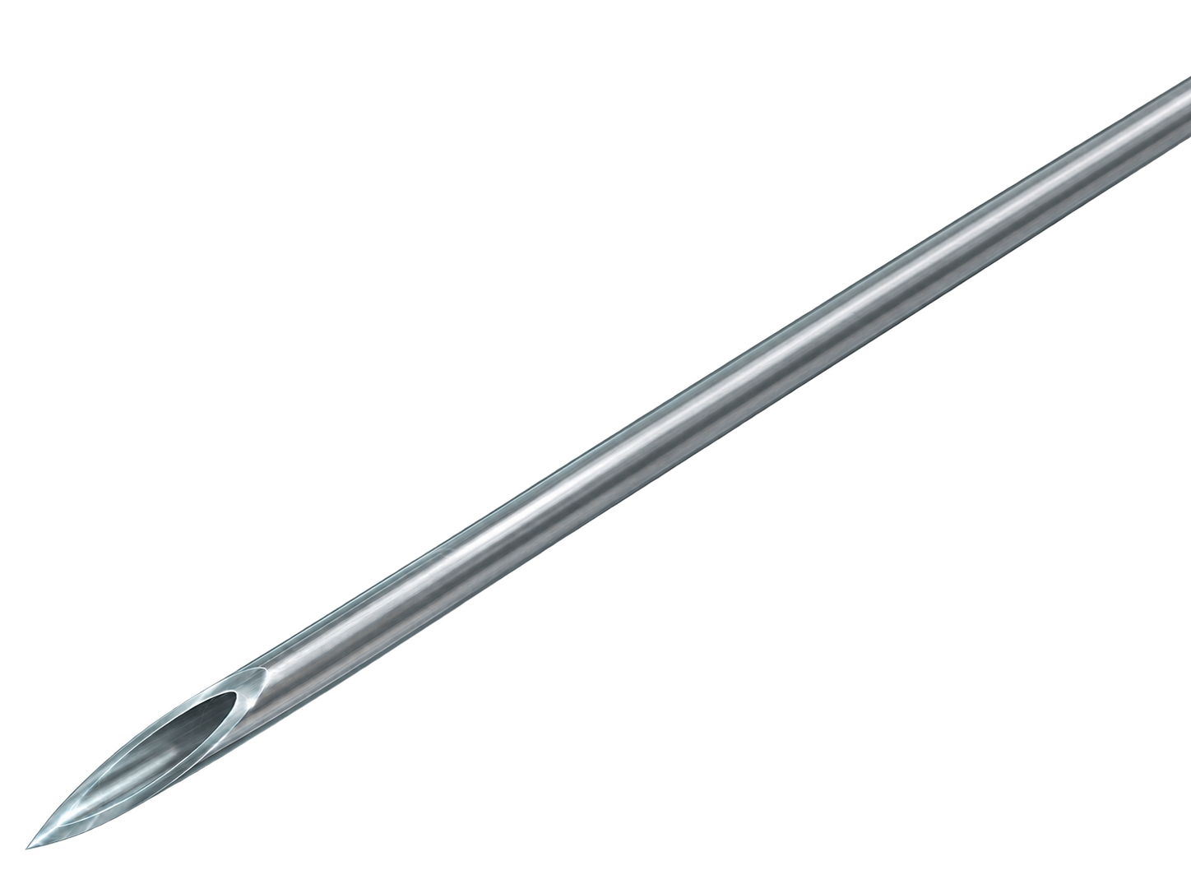
Why one section shows many ductules
A tortuous 3D network cut by one plane gives many 2D profiles, on top of true expansion
One duct beside its artery: one duct profile per section
Ductular reaction also include ductal proliferation subtype: this supports an obstructive pattern in the appropriate context.”(PSC, external compression, chronic choledocholithiasis )

Slide 13

Why one section shows many ductules
A tortuous 3D network cut by one plane gives many 2D profiles, on top of true expansion
Many ductular profiles at the tract edge
Ductular reaction also include ductal proliferation subtype: this supports an obstructive pattern in the appropriate context.”(PSC, external compression, chronic choledocholithiasis )

Slide 14
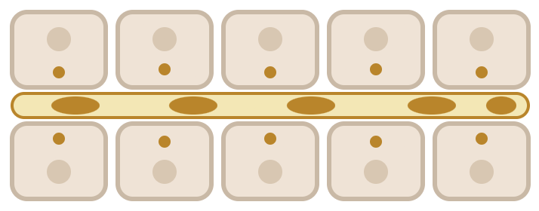
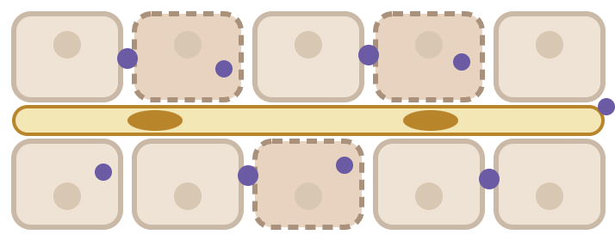
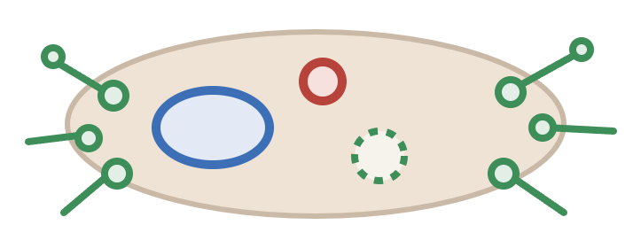
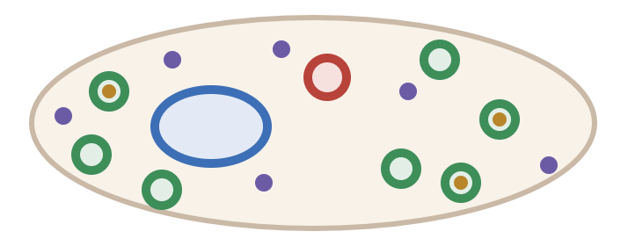
Four histological patterns by site of injury
Bland cholestasis
Cholestatic hepatitis
Chronic biliary injury
Obstructive pattern
Hepatocyte, canaliculus
Lobule, sometimes portal tract
Bile ducts
Large-duct outflow
Bile in hepatocytes and dilated canaliculi; little inflammation
Lobular bile stasis with lobular hepatitis
Duct injury or loss; ductular reaction; CK7+ hepatocytes
Well-formed ductular proliferation; oedema; neutrophils
Seen in: ICP, BRIC/PFIC, anabolic steroids, sepsis
Seen in: DILI; also viral or autoimmune hepatitis
Seen in: PBC, PSC, MDR3 deficiency, drug-related duct injury
Seen in: stones, strictures, malignancy
ALP | GGT | Bili | Other
↔ / ↑ | ↔ / ↑ | ↑ / ↑↑ | BA ↑↑
ALP | GGT | Bili | Other
↑ / ↑↑ | ↑ | ↑ / ↑↑ | ALT ↑↑
ALP | GGT | Bili | Other
↑ | ↑ | N↔ → ↑ | ALT ↔ / ↑
ALP | GGT | Bili | Other
↔ / ↑ | ↑ | ↔/↑ | ALT ↑↑
Thompson R, Vilarinho S, Miquel R ... Challenges in the diagnosis and treatment of genetic cholestasis in adults JHEP Reports, 2025; 8
Notes:
This slide replaces the old histology table with a picture-first version. Group the four patterns by predominant site of injury, and say at once that the grouping is not exclusive: cholestatic hepatitis and chronic biliary injury involve both the lobule and the portal tract, and mechanical obstruction causes secondary hepatocellular cholestasis. The first two patterns follow Thompson’s pathology section; the others follow the . Bland cholestasis: bile pigment in hepatocyte cytoplasm and, more typically, in dilated canaliculi, with hepatocyte swelling, cholestatic rosettes and sometimes multinucleation, without significant portal or lobular inflammation. Typical of ICP and recurrent intrahepatic cholestasis; also seen with sepsis, ischaemia and paraneoplastic settings such as Hodgkin lymphoma, none of which excludes an underlying genetic abnormality. Anabolic steroid injury is the classic drug example (LiverTox; the lists anabolic steroids and oestrogens). Cholestatic hepatitis: lobular bile stasis with a lobular hepatitis component, sometimes with portal inflammation and duct injury. Typical of DILI (amoxicillin–clavulanate is the classic example, from standard teaching); it can also occur in viral or autoimmune hepatitis. Chronic biliary injury: duct injury with or without loss, ductular reaction that tends to extend beyond the portal tract, periportal copper-associated protein and CK7-positive hepatocytes. Obstructive pattern: the portal-confined, well-formed form of ductular proliferation, with portal oedema, neutrophils and ductular bile plugs. It leans toward large-duct outflow impairment but overlaps with cholangiopathies. Ductular reaction itself is an umbrella term and is nonspecific; the portal-confined form is classically linked to obstruction (Desmet and Clerbaux/Jain schemes, as summarised by Pathology Outlines; the primary papers were not read), and observer agreement on the distinction is low. Schematic colours: artery red, portal vein blue, ducts green, bile amber, inflammatory cells purple. These are original drawings, not histology images; add licensed images if wanted. Evidence status: established descriptive pathology.

Slide 15
Which diagnoses produce which pattern
Bland cholestasis
Hepatocyte, canaliculus
Cholestatic hepatitis
Lobule, sometimes portal
ICP
BRIC / PFIC
Anabolic steroids
DILI
DILI
Viral or autoimmune hepatitis
AIH–PBC overlap
ABCB4 spectrum
Sepsis · ischaemia · Hodgkin
Obstructive pattern
Large-duct outflow
Chronic biliary injury
Bile ducts
Stones, strictures, malignancy
PSC
IgG4 cholangitis
PBC
PSC
IgG4 cholangitis
ABCB4 spectrum
ABCB4 spectrum
AIH–PBC overlap
DILI
Sepsis · ischaemia · Hodgkin
Name
more than one pattern
Name
possible; depends on stage or trigger
Name
one pattern only
Thompson R, Vilarinho S, Miquel R ... Challenges in the diagnosis and treatment of genetic cholestasis in adults JHEP Reports, 2025; 8
Notes:
Use this slide after the four patterns to make one point: a pattern is shared by many diseases, and one disease can produce several patterns. Read it as which patterns a disease can produce, not which diseases a pattern proves. Dark chips appear in more than one bubble. A dashed amber edge means the placement is possible and depends on stage or trigger. Typical placements. Bland cholestasis: ICP, BRIC/PFIC-type disease, sepsis, ischaemia and Hodgkin lymphoma (Thompson, pathology section); anabolic steroids (LiverTox and the ). Cholestatic hepatitis: DILI, and viral or autoimmune hepatitis (Thompson). Chronic biliary injury: PBC, PSC and MDR3 deficiency (Thompson and the ). Obstructive: stones, strictures and malignancy (large-duct outflow impairment). Multi-bubble diagnoses. DILI: bland cholestasis (steroid-type injury) and cholestatic hepatitis are typical; vanishing bile duct syndrome after drug injury places it in chronic biliary injury as a possibility. ABCB4 spectrum: ICP (bland), cholangiopathy (chronic biliary) and low phospholipid-associated cholelithiasis with stones (obstructive picture), per Thompson’s spectrum. PSC: chronic biliary injury, and obstructive physiology from dominant strictures. IgG4 cholangitis: chronic biliary injury, and large-duct strictures that mimic PSC or cholangiocarcinoma. AIH–PBC overlap: chronic biliary injury with a hepatitic component, hence cholestatic hepatitis as a possibility (standard teaching). Sepsis, ischaemia and Hodgkin lymphoma: bland cholestasis acutely; secondary sclerosing cholangitis after prolonged critical illness, ischaemic cholangiopathy and paraneoplastic ductopenia place them in chronic biliary injury as possibilities ( ’s causes of duct loss and secondary sclerosing cholangitis). Evidence status: typical placements are sourced as above. The dashed placements, and the obstructive placements of PSC, IgG4 cholangitis and ABCB4/LPAC, describe how a disease can behave and are not histology-classification results. They are supported by the and standard teaching, and I have not checked them against a primary pathology source. Not shown on purpose: parenteral nutrition, congestion and infiltrative disease.

Slide 16
However, pattern are not stand alone entities

Slide 17
Four histological patterns, none specific on its own
Pattern | Histological hallmark | Typical settings | ALP | GGT | Bilirubin | Other biochemical profile pearls
Bland cholestasis | Canalicular bile plugs ± hepatocellular bile pigment; minimal inflammation or necrosis | Anabolic steroids, ICP, BRIC/PFIC-spectrum disorders, sepsis | Normal to ↑; often modest relative to bilirubin | Typically, normal or mildly ↑ | Variable; can be markedly ↑ (conjugated) | Severe jaundice can occur with surprisingly modest ALP/ALT. Serum bile acids often ↑↑
Cholestatic hepatitis | Canalicular cholestasis with lobular inflammation and hepatocellular injury | DILI (e.g., amoxicillin–clavulanate), viral hepatitis, some immune-mediated injuries | ↑, sometimes markedly | Usually ↑ | Variable | ALT may be substantially ↑. Mixed or cholestatic R-ratio is common
Chronic biliary injury | Native duct injury or loss, ductular reaction, periportal cholate stasis, copper-associated protein, CK7-positive periportal hepatocytes | PBC, PSC, MDR3 deficiency, chronic drug-related duct injury | Usually ↑ | Usually ↑ | Normal early ↑ with advanced disease | ALP/GGT-predominant profile is typical. Bilirubin elevation carries prognostic significance, particularly in PBC
Obstructive biliary pattern | Often well-formed ductular proliferation, portal edema, neutrophils ± ductular bile plugs | Choledocholithiasis, biliary strictures, malignancy, large-duct cholangiopathies | Usually ↑; may be normal early | Usually ↑ | often conjugated ↑ with sustained obstruction | Acute obstruction may initially produce a marked AST/ALT spike, preceding the typical cholestatic biochemical pattern
Thompson R, Vilarinho S, Miquel R ... Challenges in the diagnosis and treatment of genetic cholestasis in adults JHEP Reports, 2025; 8
Notes:
This table follows the anchor review’s pathology section, written with a liver pathologist, supplemented by the . Bland cholestasis: bile pigment in hepatocyte cytoplasm and, more typically, in dilated canaliculi, with hepatocyte swelling, cholestatic rosettes and sometimes multinucleation, but without significant portal or lobular inflammation. Thompson calls this pattern typical of ICP and recurrent intrahepatic cholestasis, and notes it also occurs in sepsis, ischaemia and paraneoplastic settings such as Hodgkin lymphoma, adding that these settings cannot exclude an underlying genetic abnormality. That last point is on the slide because it is easily forgotten. Cholestatic hepatitis: lobular bile stasis with a lobular hepatitis component, sometimes with portal inflammation and duct injury. This is the pattern typical of drug-induced liver injury; in viral or autoimmune hepatitis the necroinflammatory component usually dominates. Biliary pattern: duct injury with or without loss, ductular reaction, periportal cholate stasis, copper or copper-associated protein deposition, and aberrant CK7 expression in periportal hepatocytes. Obstructive pattern: ductular reaction with portal oedema, neutrophils and ductular bile plugs, which supports outflow impairment but overlaps with intrahepatic cholangiopathies ( ). Teaching line for juniors: the pattern narrows the differential; it does not name the disease. Evidence status: established descriptive pathology.

Slide 18
CHOLESTASIS: BEYOND BILE FLOW
3
2
Pruritus:
4
mechanisms
5
The biopsy
Adult genetic
and patterns
and treatment
Established and
cholestasis
emerging
therapeutics
1
What is
cholestasis
Take Home
Notes:
Transition slide 1 of 5. Same slide repeated between sections; the lit branch marks the topic that starts now. Order: What is cholestasis; The biopsy and patterns; Pruritus: mechanisms and treatment; Adult genetic cholestasis; Established and emerging therapeutics.

Slide 19
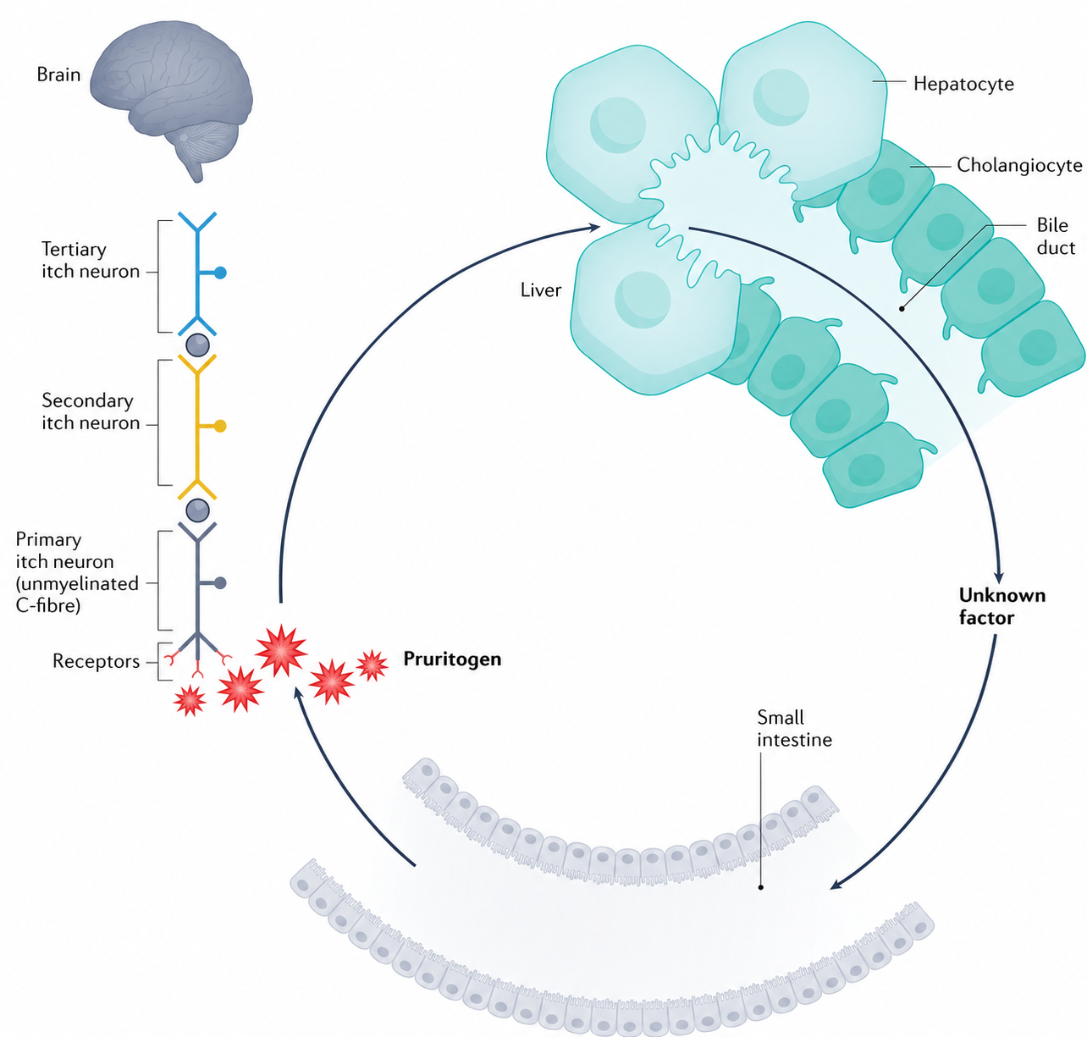
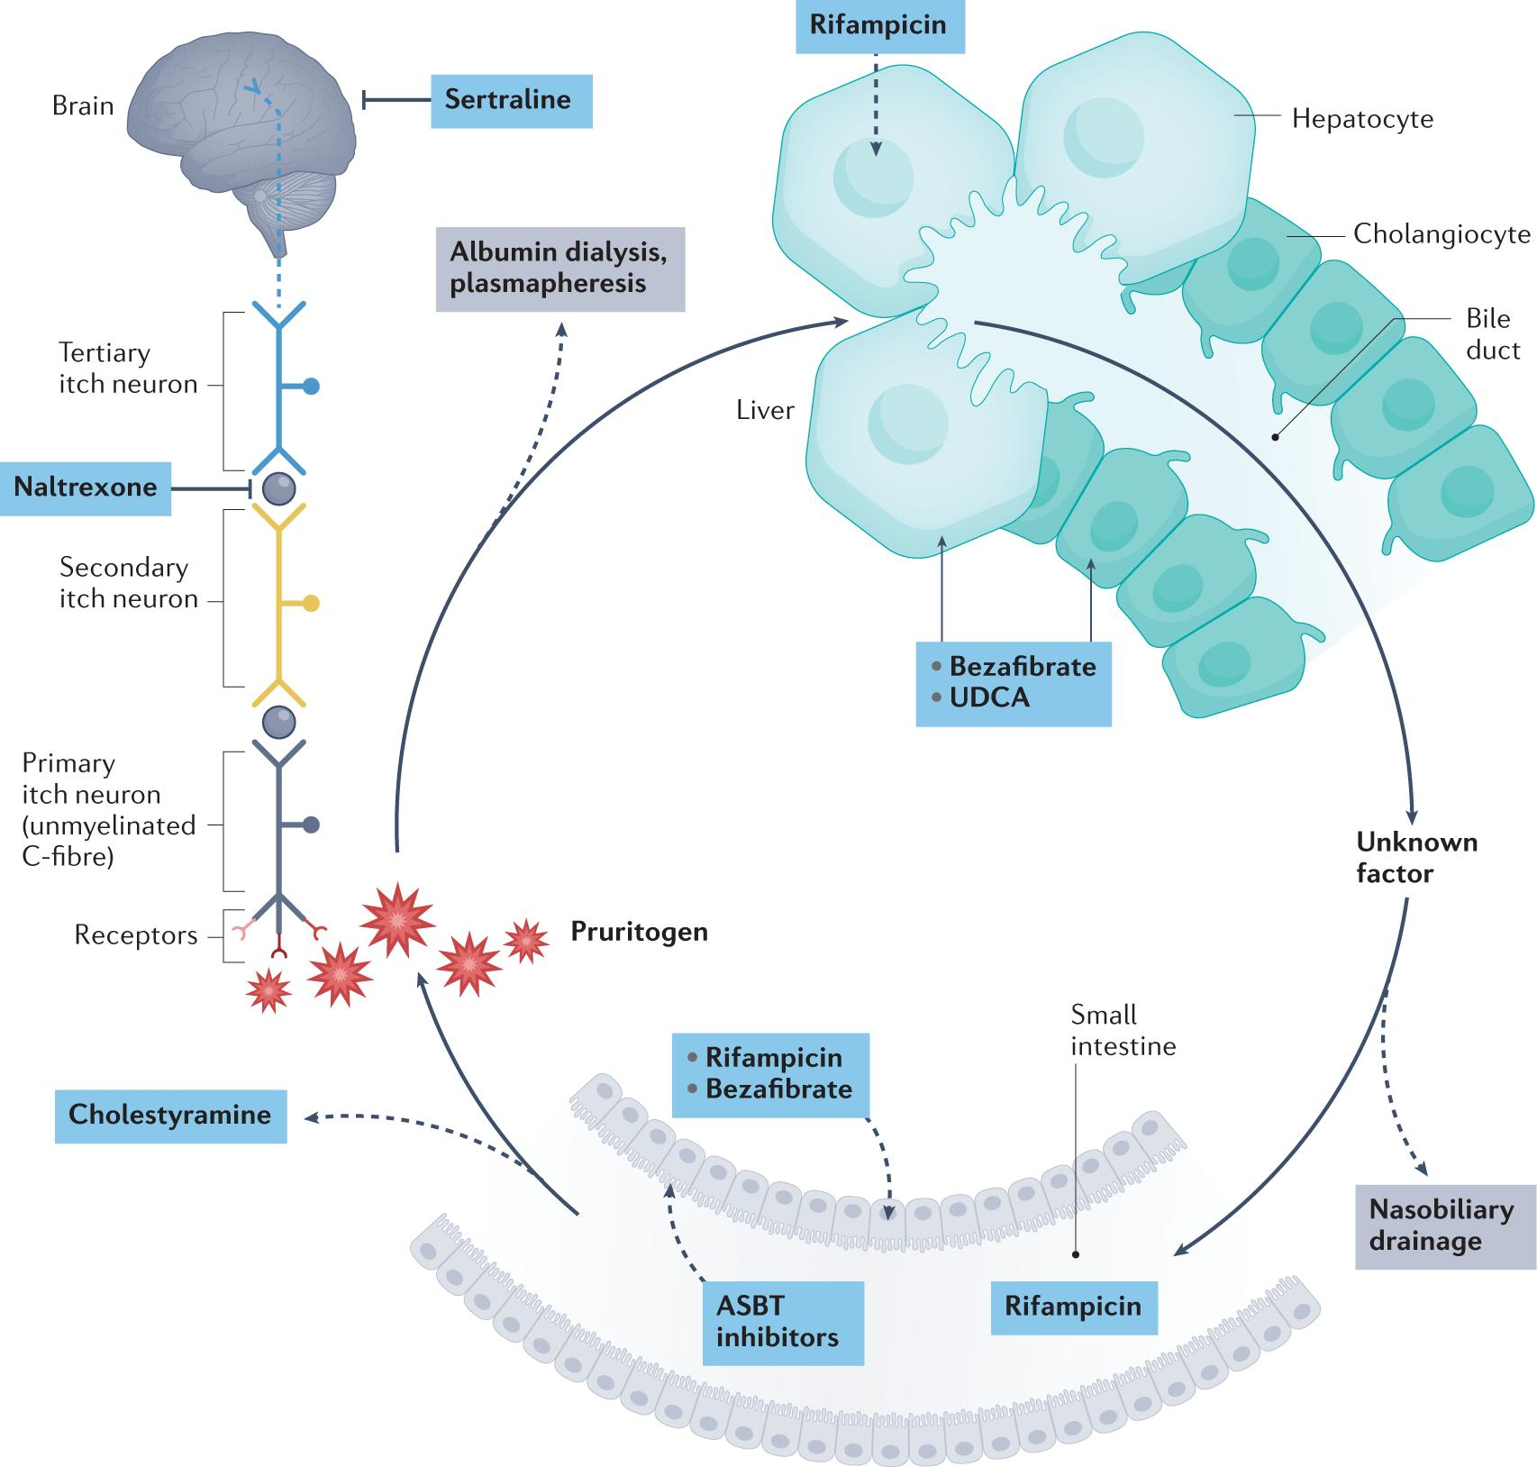
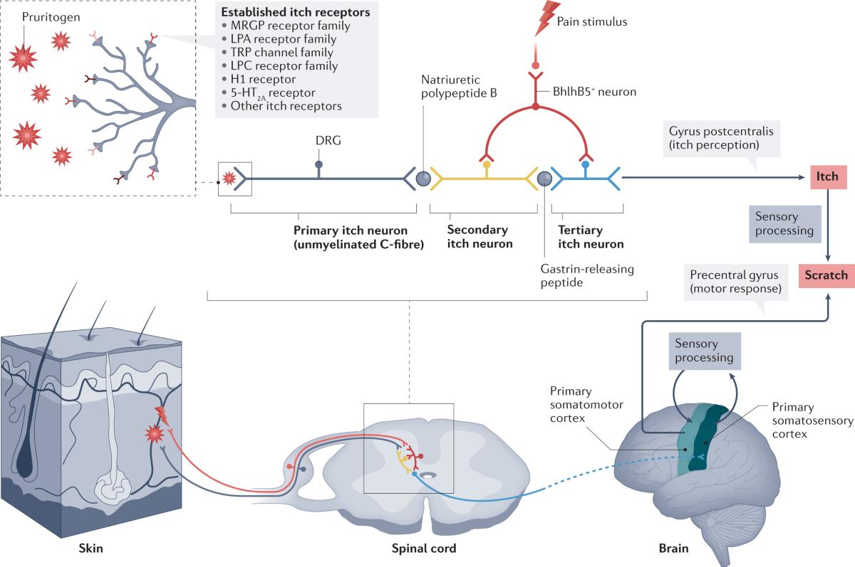
Mechanisms of pruritus are poorly understood and sub-optimally treated
Beuers, U., Wolters, F. & Oude Elferink, R.P.J. Mechanisms of pruritus in cholestasis: understanding and treating the itch. Nat Rev Gastroenterol Hepatol 20, 26–36 (2023).

Slide 20
Cholestatic itch: from liver to cortex
Six links in the pathway, one open question
1
Liver
2
Candidate mediators
3
Intestine
Cholestasis generates or accumulates circulating pruritogens; their identity and relative contributions remain uncertain.
Lysophospholipids (autotaxin–LPA) and sulfated progesterone metabolites. Total serum bile acids and bilirubin conjugates are unlikely to dominate.
Enterohepatic circulation may sustain pruritogen availability; interrupting intestinal reabsorption can reduce itch.
4
Skin
5
Neural pathway
6
Central modulation
Pruritogens activate receptors on peripheral, unmyelinated C-fibres, initiating the itch signal.
The signal travels via primary, secondary and tertiary itch neurons to the cerebral cortex, where itch is perceived.
Neural signalling and endogenous opioid pathways shape itch perception, so treatments acting beyond the liver can work.
Key uncertainty: no single established circulating pruritogen explains cholestatic itch across all patients and diseases.

Slide 21
The itch ladder: stepwise, with the cautions that matter
Cholestyramine
Disease Specific
PBC
1
First line; separate from other drugs by about 4 h
Watch: binds other drugs; poorly tolerated by many
Rifampicin
Bezafibrate: FITCH: ≥50% itch reduction, 45% vs 11%.
Seladelpar: Significant itch benefit in RESPONSE.
Elafibranor: Itch endpoint not met in ELATIVE.
Linerixibat: FDA-approved for PBC itch; diarrhea 62% vs 18%.
2
Second line
Watch: hepatotoxicity (monitor liver tests); many interactions
Naltrexone
3
Third line; start low
Watch: opioid withdrawal-like reactions; not with opioids
Sertraline
4
Fourth line
Watch: modest effect only
5
Refractory itch
Transplant assessment
EASL. J Hepatol. 2017;67:145–172., Thompson et al. JHEP Rep. 2026;8:101625.; de Vries et al. (FITCH). Gastroenterology. 2021;160:734–743.
Hirschfield et al. (RESPONSE). NEJM. 2024;390:783–794.; Kowdley et al. (ELATIVE). NEJM. 2024;390:795–805.; Hirschfield et al. (GLISTEN). Lancet Gastroenterol Hepatol. 2026;11:22–33.; FDA. Linerixibat (LYNAVOY), prescribing information, 2026.
Notes:
Rebuild of the itch ladder slide. The ladder is the generic, guideline-order sequence: cholestyramine, rifampicin, naltrexone, sertraline, then refractory itch as the true last rung (specialist and transplant assessment). The side panel is a parallel track chosen by diagnosis; it is not a fifth step. Step height is equal on purpose: the old version used rising heights that implied rising efficacy, which no data supports. Cautions: cholestyramine binds other drugs (the 4 h separation is from the earlier slide; check the exact interval against the guideline you cite). Rifampicin: hepatotoxicity, so monitor liver tests; many interactions. Naltrexone: start low because of opioid withdrawal-like reactions; not for patients on opioids. Sertraline: modest effect only. Doses are left off the slide on purpose. PBC track. FITCH (de Vries et al, Hepatology 2021; abstract read): 74 randomised patients with PSC, PBC or secondary sclerosing cholangitis and moderate to severe itch, bezafibrate 400 mg or placebo for 21 days; at least 50% itch reduction in 45% vs 11% (P=0.003), 55% in the PBC subgroup. Short trial in a mixed population, so do not read it as PBC-only or long-term evidence. Seladelpar: itch improved more than placebo in RESPONSE (−3.2 vs −1.7, P=0.005, month 6, patients with baseline itch of 4 or more). Elafibranor: no significant itch difference in ELATIVE (P=0.20). Linerixibat (Lynavoy), an ileal bile acid transporter inhibitor: reported as FDA-approved in March 2026 for cholestatic pruritus in adults with PBC on the strength of the GLISTEN trial; the news report I read gave no itch score figures, said absolute reductions were modest, and gave diarrhoea in 61% and abdominal pain in 18%. I did not read the label or the GLISTEN paper; check them before presenting numbers. PFIC and Alagille: IBAT inhibitors have their evidence mainly in children; I did not verify current labels or adult data. Evidence status: ladder order and cautions are standard guideline content that I did not re-verify against the full guideline text in this session; the side panel figures are from the sources named above.

Slide 22
CHOLESTASIS: BEYOND BILE FLOW
3
2
Pruritus:
4
mechanisms
5
The biopsy
Adult genetic
and patterns
and treatment
Established and
cholestasis
emerging
therapeutics
1
What is
cholestasis
Take Home
Notes:
Transition slide 1 of 5. Same slide repeated between sections; the lit branch marks the topic that starts now. Order: What is cholestasis; The biopsy and patterns; Pruritus: mechanisms and treatment; Adult genetic cholestasis; Established and emerging therapeutics.

Slide 23


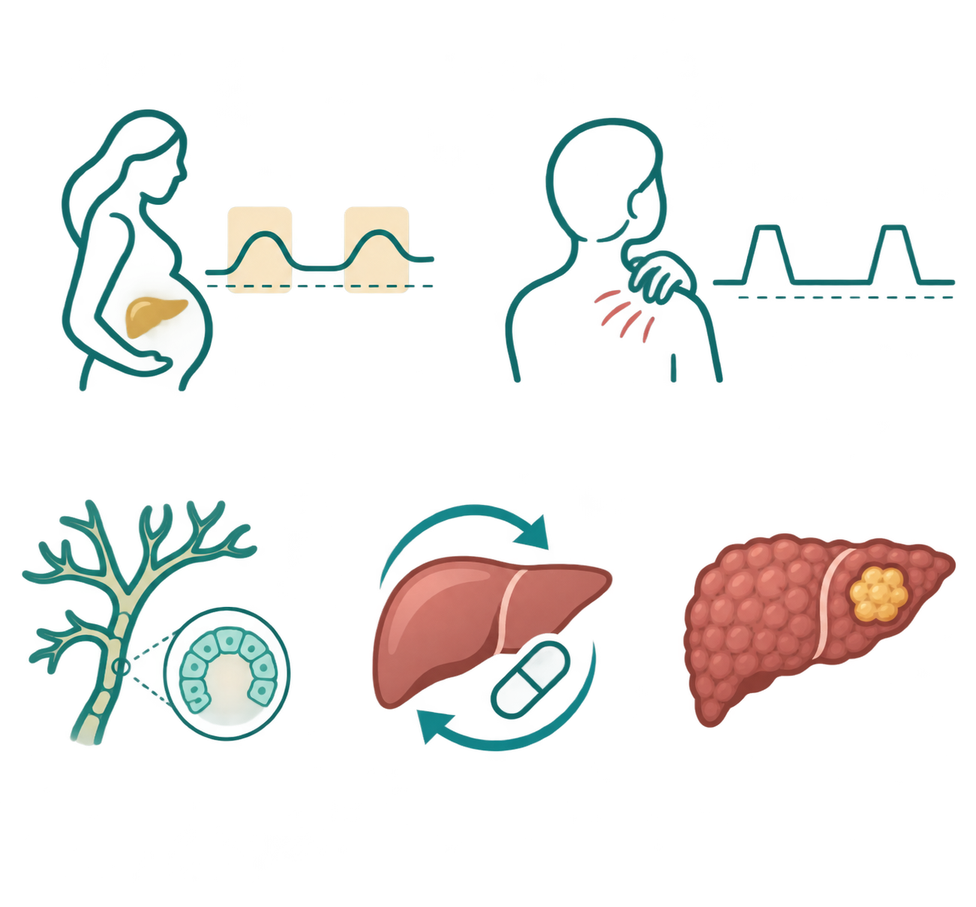

Six adult faces of inherited cholestasis
Early or recurrent stones
Recurrent or severe ICP
Episodic itch or jaundice
Stones before 40; pain after cholecystectomy; intrahepatic foci
Attacks years apart, normal in between; GGT often normal
ICP in each pregnancy; liver tests still abnormal after delivery
ABCB4
ABCB4
ABCB11
ATP8B1
ABCB11
“Seronegative PBC” or small-duct PSC
Repeated or prolonged DILI
Cirrhosis or liver cancer
AMA-negative, normal MRCP, onset in the young
AMA -ve
Sometimes the first presentation; ask about family liver disease
More than one episode, or a drug plus pregnancy
ABCB4
ABCB11
ABCB4
ABCB4
ABCB11
Thompson et al, JHEP Rep 2026 · Nayagam et al, Hepatol Commun 2022;6:2654
Notes:
Six ways adults with inherited cholestasis actually present. Each card now carries three things: a sketch of the liver-test course over time, the clue to ask for, and the genes most often linked to that presentation. The sketches are teaching drawings, not patient data. The point of the slide is in the subtitle: the shape over a lifetime is the clue, and a single set of liver tests rarely shows it. Thompson describes the adult spectrum as elevated liver enzymes, pruritus, episodic cholestasis, ICP, DILI, gallstones and LPAC, more severe late-onset PFIC, progressive liver disease, hepatobiliary malignancy, or combinations. 1. Early or recurrent stones: flares continue after cholecystectomy (vertical line). LPAC, which we look at next, is the most actionable adult presentation; ABCB4. 2. Recurrent or severe ICP: a rise in each pregnancy, and tests that stay abnormal after the last delivery. Nayagam and colleagues found pregnancy-associated liver dysfunction in about three-quarters of adults with ABCB4 variants and over 80% with ABCB11 variants in their selected cohort. Thompson also lists ATP8B1, TJP2 and NR1H4 with ICP. 3. Episodic itch or jaundice: attacks, normal intervals, often normal GGT. BRIC-like phenotypes; ATP8B1 and ABCB11, also TJP2 (Thompson Table 1). 4. Seronegative PBC or small-duct PSC in a young patient: persistent, slowly rising tests. Thompson warns these labels may conceal PFIC-spectrum disease; ABCB4 is the main cholangiopathy gene. 5. Repeated or prolonged DILI, or cholestasis after more than one stressor (drug plus pregnancy). Thompson Table 1 lists DILI with ABCB11; the ABCB4 link comes from the , and association strength varies by drug and study. 6. Cirrhosis or liver cancer, sometimes the first presentation. Thompson lists HCC with ABCB11 and TJP2 and cholangiocarcinoma with ABCB4, and notes malignancy can be the initial presentation. The green card is our patient. Ask the room which faces she shows: at least two, stones and ICP, and arguably three if the persistent cholestasis counts. The bar is the caution: a listed gene is a candidate to test, not the diagnosis. Most gallstones, ICP and DILI are multifactorial. Evidence status: presentations supported by cohort and case-series data; proportions come from selected referral populations and do not apply to unselected patients. Gene lists are the main associations in Thompson Tables 1 and 2, not complete panels.

Slide 24
Genetic severity shapes disease expression; modifiers influence penetrance
Genetic load
Second hit
Pregnancy, hormones, drugs, infection and cytokines, coexisting liver disease
GENOTYPE AND PHENOTYPE
TO REACH DISEASE THRESHOLD
SECOND HIT
Early Death/ Transplant
Biallelic, truncating
Not required
Early-onset progressive PFIC
Pediatric and Young Adult
Biallelic, residual function
Small trigger
Late-onset PFIC or recurrent episodes
Adult Phenotypes
Monoallelic, deleterious
Adult phenotypes, incomplete penetrance: ICP, LPAC, DILI, chronic cholestasis
Variable, Typically Substantial trigger
Minimal Significance
Common variant
Essential, with other hits
Risk modifier, mainly alongside a deleterious variant
Notes:
Replacement for the “four kinds of genetic contribution” slide. The dark end cap on each bar is the disease threshold. The teal part is what the genotype supplies on its own; the striped amber part is what a second hit has to add to cross the threshold. Biallelic truncating variants: the genotype alone crosses the threshold, so no second hit is required and the disease appears early (progressive PFIC). Biallelic with residual function: close to the threshold; a small trigger (a drug, an infection, pregnancy) can tip a late-onset or episodic course. Monoallelic deleterious variants: a substantial second hit is usually needed, which explains incomplete penetrance and adult phenotypes such as ICP, LPAC, DILI-type injury and chronic cholestasis. Common variants: a small effect that matters mainly on top of a deleterious variant plus other hits. The bar lengths are a teaching device, not measurements; no study gives these proportions. The statement that second hits differ between relatives is an explanation for variable expression, not a proven mechanism in every family; other modifiers also contribute.

Slide 25
Four genes that matter most in adult clinics, but you need to remember two
Gene · protein | What fails | GGT | Adult presentations | Beyond the liver
ABCB4 · MDR3 | Phospholipid into bile | High | LPAC, ICP, biliary fibrosis, cirrhosis, HCC and CCA | —
ABCB11 · BSEP | Bile salt export | Low or normal | Episodic cholestasis, ICP, DILI, gallstones, HCC | —
ATP8B1 · FIC1 | Membrane lipid asymmetry | Low or normal | Episodic cholestasis, ICP, raised liver tests | Diarrhoea, hearing loss, pancreatitis
TJP2 | Tight-junction seal | Low or normal | Episodic cholestasis, ICP, gallstones, HCC | Neurological/respiratory features reported; extrahepatic phenotype less well defined
Rarer genes (NR1H4, USP53, LSR, MYO5B, SEMA7A, KIF12 and others): backup slide B2.
Thompson R, Vilarinho S, Miquel R ... Challenges in the diagnosis and treatment of genetic cholestasis in adults JHEP Reports, 2025; 8
modified from Ibrahim et al, Hepatology 2022 · EASL genetic cholestasis CPG 2024
Notes:
The four genes most often found in adults, with the clinical associations Thompson lists in Tables 1 and 2. A green row marks the cholangiopathy gene; the others cause primary cholestasis. ABCB4 encodes MDR3, the phosphatidylcholine floppase. Thompson describes MDR3 deficiency as the most common genetic condition in adults with biopsy-proven cholangiopathy, with presentations including sclerosing cholangitis-like disease, biliary fibrosis, LPAC, gallstones, ICP and cholangiocarcinoma, and notes a strong association of cholangiopathies, MDR3 in particular, with both hepatocellular carcinoma and cholangiocarcinoma. GGT is typically raised. ABCB11 encodes BSEP. Its table lists PFIC, episodic cholestasis, drug-induced liver injury, ICP, hepatocellular carcinoma, raised liver tests and gallstones. ATP8B1, encoding FIC1, and TJP2 cause low-GGT primary cholestasis with notable extrahepatic features: diarrhoea, hearing loss and pancreatitis. Asking about these features costs nothing and can point toward the gene. The GGT column is the classical association. In adults, partial-function and heterozygous variants blur it, as discussed in Lecture 1. Nayagam and colleagues also found that ATP8B1 variants in adults often had low predicted pathogenicity and frequently coexisted with an alternative cause of liver disease, a useful caution against over-reading an ATP8B1 finding. Evidence status: gene–disease associations established for PFIC; adult phenotype associations supported by cohort and case-series data.

Slide 26
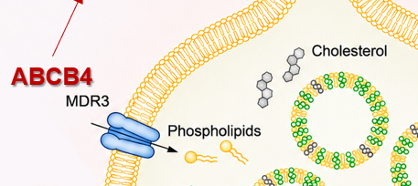

LPAC: a transporter disease that looks like ordinary gallstones
Low biliary phospholipid lets cholesterol crystallise inside the liver
Less MDR3 activity
Phospholipid-poor bile
Cholesterol crystals and microliths
Intrahepatic stones, pain, cholangitis
EPIDEMIOLOGY
SUSPECT IT WHEN
WHY IT MATTERS
~1% of adults with symptomatic gallstone disease
Estimated prevalence: 10–40 per 100,000
Female predominance: approximately 75–77%.
Median age at symptom onset: 27 years.
•ABCB4 variants: detectable in approximately 30–50% of clinically diagnosed cases.
Biliary symptoms began before 40
The gallbladder was not the whole problem
Symptoms recur after cholecystectomy
Standard ultrasound misses microliths unless asked
Intrahepatic hyperechoic foci or comet tails
Not every LPAC patient has an ABCB4 variant
Supportive: ICP, family history of early stones
UDCA is used; outcome data are observational
EASL genetic cholestasis CPG, J Hepatol 2024;81:303 (LPAC features) · Rosmorduc & Poupon, Orphanet J Rare Dis 2007;2:29
Thompson R, Vilarinho S, Miquel R ... Challenges in the diagnosis and treatment of genetic cholestasis in adults JHEP Reports, 2025; 8
Notes:
LPAC is the ABCB4 spotlight. The mechanism follows directly from Lecture 1: reduced MDR3 activity means less phosphatidylcholine in bile, lower capacity to keep cholesterol in mixed micelles, crystallisation and intrahepatic microlithiasis, then pain, cholangitis and recurrence after cholecystectomy. Thompson notes that the reduced capacity to form mixed micelles increases the risk of gallstone disease and LPAC. The three features in the left panel are those listed in the EASL guideline: onset of biliary symptoms before age 40, recurrence of biliary symptoms after cholecystectomy, and hyperechoic intrahepatic foci or comet-tail images on ultrasound. ICP and a family history of early gallstones are supportive. The adds a practical point: standard ultrasound reports may miss intrahepatic microlithiasis unless the question is asked explicitly, which is exactly what happened in our case. Why it matters. The gallbladder was not the sole source of symptoms, so further surgery is not the answer. Not every patient with the clinical syndrome has an identified ABCB4 variant, so a negative test does not remove the phenotype. UDCA is widely used in specialist care for LPAC, and EASL recommends UDCA for patients with at least one ABCB4 missense variant and a clinical phenotype (level of evidence 3, strong recommendation), but outcome evidence is observational. Do not imply that every early gallstone needs sequencing. Evidence status: syndrome and association established; treatment effect supported by observational data only.

Slide 27
What genetic testing finds in selected adults: four complementary studies
Different populations, different endpoints — variant detection is not always diagnosis.
Nayagam 2022
Gabrielli 2026
356 selected adults, clinical sequencing of cholestasis genes
233 adults with cryptogenic cholestasis, 4 Italian centres
28.4%
19.3%
101/356 with at least one variant
Patients per gene; counts overlap (sum 109)
45/233 with a P/LP variant
Second bar includes the first; do not add. PFIC-gene P/LP: 15.5%
Variants are common, often heterozygous; detection does not establish causality.
ICP and early-onset gallstones independently predicted PFIC-gene variants.
Nayagam JS, Hepatol Commun 2022;6:2654
Gabrielli F, Dig Liver Dis 2026;58(Suppl 1):S12
Cristoferi 2026
Silva Rodriguez 2026
263 adults with unexplained cholestasis, 8 Italian centres, 77-gene panel
86 highly selected referrals for suspected genetic cholestasis; 83% adults
4.2%
28.9%
Established 4.2%
43%
Possible 28.9%
established (11/263)
possible (76/263)
Neither 66.9%
37/86 P/LP variants after reanalysis
+11 patients; P/LP yield, not proven disease
Possible genetic contribution is far more common than a definitive diagnosis.
Reanalysis raises detection; yield depends on panel breadth and interpretation.
Cristoferi L, Digestive and Liver Disease, 58, S108-S109
Silva Rodriguez M, JHEP Rep 2026, DOI 10.1016/j.jhepr.2026.102076
Notes:
SPEAKER NOTES - what genetic testing finds in selected adults.
The four red percentages are different quantities. Do not call them all diagnostic yield and do not average or add them.
Nayagam 2022 (Hepatol Commun 2022;6:2654-2664, DOI 10.1002/hep4.2051): 356 selected adults sequenced for cholestasis genes; 101/356 (28.4%) had at least one variant. Patients per gene: ABCB4 46, ABCB11 35, ATP8B1 28. These sum to 109 because some patients had variants in more than one gene; they are not exclusive groups. Many variants are heterozygous; detection does not establish causality.
Gabrielli 2026 (conference abstract; Dig Liver Dis 2026;58(Suppl 1):S12-S13, DOI 10.1016/j.dld.2026.01.029): 233 adults with adult-onset cryptogenic cholestasis, four Italian tertiary centres. 45/233 (19.3%) had a P/LP variant; 106/233 (45.5%) had a P/LP variant or a VUS (the second category includes the first); 36/233 (15.5%) had P/LP variants in PFIC-related genes. ICP (adjusted OR 5.31, 95% CI 1.79-15.78) and early-onset cholelithiasis (adjusted OR 3.16, 1.42-7.03) predicted PFIC-gene P/LP detection. These ORs do not describe the chance of a confirmed genetic diagnosis.
Cristoferi 2026 (conference abstract; Dig Liver Dis 2026;58(Suppl 1):S108-S109, DOI 10.1016/j.dld.2026.01.170): 263 adults with unexplained cholestasis, eight Italian centres, 77-gene panel. 11/263 (4.2%) genetically established diagnosis; 76/263 (28.9%) possible genetic contribution; 176/263 (66.9%) neither. The abstract mentions 50 monoallelic P/LP variants in recessive disease genes and 24 selected warm/hot VUS; these sum to 74, not 76, so they are not shown as a breakdown.
Silva Rodriguez 2026 (JHEP Reports, DOI 10.1016/j.jhepr.2026.102076): 86 highly selected referrals, 83% adults. Initial P/LP yield 26/86 (30%); after systematic exome reanalysis 37/86 (43%), about 13 points higher (+11 patients). Reported by gene panel: Nancy 41-gene 43% P/LP; EASL 2024 core 18-gene panel 34% at reanalysis. The 43% is a variant-level yield in highly selected patients, not proof that 43% had established monogenic disease, and it is not comparable with Cristoferi's 4.2%.
The two Italian cohorts may draw on overlapping recruitment networks; independence of participants should not be assumed.
Source status: all figures were built from the supplied brief. I checked the arithmetic (percentages and sums), but I could not open the Nayagam, Cristoferi or Silva Rodriguez abstracts myself, so the numbers, the panel figures and the publication date are unverified against the papers.

Slide 28
What a genetic result can change in an adult
1 · TREATMENT
2 · SURVEILLANCE
UDCA
Every 3–6 months
ABCB4 missense variant with a phenotype
HCC ultrasound in biallelic BSEP deficiency
HSD3B7 or AKR1D1 deficiency: oral primary bile acid
Known pathogenic ABCB4: review every 6 months, imaging at least yearly
Level 3 · strong recommendation
Levels 2–4 · intervals are expert opinion
3 · FAMILY AND COUNSELLING
4 · DIAGNOSIS
First-degree relatives
Reclassify
MDR3 deficiency: offer testing, with counselling beforehand
An inherited cholangiopathy behind “seronegative PBC” or small-duct PSC
Explains unexplained ICP or gallstones in the family; informs future pregnancies
Ends repeated work-up; questions the need for immunosuppression
Level 2 · strong recommendation
Clinical judgement · not graded by EASL
EASL CPG on genetic cholestatic liver diseases, J Hepatol 2024;81:303 ·
Thompson R, Vilarinho S, Miquel R ... Challenges in the diagnosis and treatment of genetic cholestasis in adults JHEP Reports, 2025; 8
Notes:
Redesign of “What a genetic result can change in an adult”. Each card leads with the answer in large type; the pips show the EASL level of evidence (more filled = stronger). Dashed amber marks a point EASL does not grade. Treatment (level 3, strong): UDCA is recommended for patients with a clinical phenotype and at least one ABCB4 missense variant. Patients with HSD3B7 or AKR1D1 deficiency (primary bile acid synthesis defects, very rare) should receive an oral primary bile acid. Surveillance (levels 2 to 4): in BSEP deficiency, HCC screening every 3 months for biallelic truncating variants and every 3 to 6 months for missense variants (expert opinion). Known pathogenic ABCB4: review at least every 6 months (level 3), ultrasound or MRI/MRCP at least yearly (level 4). The HCC schedules apply to established biallelic disease, not to an adult with an isolated heterozygous ABCB11 variant. The pips for this card show the range: two filled for the weakest level, two striped up to the strongest. Family (level 2, strong): offer testing to first-degree relatives of patients with MDR3 deficiency, with counselling first. The ICP, gallstone and pregnancy statements are practical reasoning, not guideline text. No outcome data show that cascade testing prevents cirrhosis, cancer or death. Diagnosis (not graded): a convincing result can reclassify atypical PBC or small-duct PSC and reduce repeated investigation. A variant alone must never overturn a well-supported autoimmune diagnosis. Evidence status: levels are those in the EASL text I read; the four-consequence framing is mine.

Slide 29
CHOLESTASIS: BEYOND BILE FLOW
3
2
Pruritus:
4
mechanisms
5
The biopsy
Adult genetic
and patterns
and treatment
Established and
cholestasis
emerging
therapeutics
1
What is
cholestasis
Take Home
Notes:
Transition slide 1 of 5. Same slide repeated between sections; the lit branch marks the topic that starts now. Order: What is cholestasis; The biopsy and patterns; Pruritus: mechanisms and treatment; Adult genetic cholestasis; Established and emerging therapeutics.

Slide 30
Treat three targets separately, and judge each by its own outcome
1 · THE DISEASE PROCESS
2 · THE BILE ACID BURDEN
3 · THE SYMPTOMS
Slow progression
Reduce toxicity or pool size
Relieve itch and fatigue
by death, transplant, decompensation
by ALP, serum bile acids, histology
by validated patient-reported scores
UDCA in PBC; drainage when obstructed
? PPAR in the future
PPAR agonists, fibrates, IBAT inhibitors
Sequestrants, rifampicin, naltrexone, sertraline, IBAT inhibitors & PPAR
Thompson R, Vilarinho S, Miquel R ... Challenges in the diagnosis and treatment of genetic cholestasis in adults JHEP Reports, 2025; 8
Notes:
Thompson frames treatment of genetic cholestasis at several levels: treat the underlying pathology if possible; if not, treat cholestasis; and finally treat its consequences, including symptoms and nutrition. The states the same idea as three aims that should not be conflated: prevent disease progression, reduce hepatocellular bile acid exposure, and relieve symptoms. Each aim has its own outcome measure. Disease progression is judged by hard outcomes: death, transplantation and decompensation. Bile acid burden is judged by surrogates such as ALP, serum bile acids or histology. Symptoms are judged by validated patient-reported measures, such as the worst-itch numerical rating scale. The dark bar corrects the most important error in the first deck. Its “what is proven” slide classified itch improvement with IBAT inhibitors as “surrogate only”. That was wrong: a validated itch score is a direct measure of patient benefit. Conversely, an ALP response, the basis of US accelerated approvals for the PPAR agonists, is a surrogate; it does not by itself prove reduced death or transplantation. Anatomical correction remains indispensable when obstruction is present; bile acid pathway drugs cannot substitute for drainage of an infected obstructed system. Evidence status: framework established.

Slide 31
UDCA: The easy answer
Setting | Evidence | Position
PBC | Standard disease-directed first-line therapy | Established
ABCB4 disease | EASL strong recommendation; retrospective outcome data | Recommended
PSC | No proven effect on hard outcomes; high dose harmful | Used, Not proven
Genetic primary cholestasis | No evidence of benefit; may harm in severe cholestasis | Unproven
Logic: UDCA makes bile less toxic. That helps most when toxic bile injures ducts, as in MDR3 deficiency.
Thompson R, Vilarinho S, Miquel R ... Challenges in the diagnosis and treatment of genetic cholestasis in adults JHEP Reports, 2025; 8
EASL genetic cholestasis CPG 2024 · Lindor et al, Hepatology 2009;50:808 (high-dose UDCA in PSC)
Notes:
UDCA is used in almost every cholestatic disease, but its evidence base differs completely between them. PBC: established, disease-directed first-line therapy. ABCB4 disease: EASL gives a strong recommendation, based on level 3 evidence, for patients with at least one missense variant and a clinical phenotype. Thompson explains the logic: in MDR3 deficiency, bile acid toxicity in bile is at the heart of the disease, so reducing the hydrophobicity of the bile acid pool is entirely logical, and retrospective data show that biochemical improvement after UDCA is associated with better outcomes. PSC: UDCA has not been shown to improve meaningful long-term outcomes, and high-dose UDCA, 28 to 30 mg/kg/day, was associated with a higher rate of serious adverse outcomes in the randomised trial by Lindor and colleagues, Hepatology 2009. High doses should not be normalised in PSC. Genetic primary cholestasis, such as BSEP or FIC1 deficiency: Thompson is blunt. UDCA is itself a bile acid and might even be harmful in severe cholestasis; there are suggestions it can increase BSEP expression, but evidence of clinical benefit is missing. The bottom bar is the mechanism-to-treatment logic of the whole series: UDCA helps most when the problem is toxic bile injuring ducts. Norucholic acid and other hydrophilic bile acids are logical but unproven. Evidence status as labelled.

Slide 32
PPAR agonists in PBC: strong biochemistry, outcomes still pending
not a head-to-head comparison
SELADELPAR RESPONSE, 12 MONTHS
ELAFIBRANOR ELATIVE, 52 WEEKS
Composite biochemical response
Composite biochemical response
61.7%
51%
20.0% placebo
4% placebo
ALP normalisation: 25% vs 0%
ALP normalisation: 15% vs 0%
Itch improved in patients with moderate–severe itch
Key itch endpoint not significant
Hirschfield et al, NEJM 2024;390:783 (RESPONSE) · Kowdley et al, NEJM 2024;390:795 (ELATIVE) · Alamgir & Kowdley, Gastroenterol Hepatol 2026;22(5). Redrawn
Notes:
Both trials enrolled patients with PBC and an inadequate response to, or intolerance of, UDCA. Bar lengths are drawn to scale on a common percentage axis. RESPONSE (seladelpar, a PPAR-δ agonist, NEJM 2024): at 12 months, 61.7 percent on seladelpar versus 20.0 percent on placebo met the composite biochemical endpoint, and ALP normalised in 25 percent versus 0 percent. Seladelpar also improved the prespecified pruritus endpoint in patients with moderate to severe itch at baseline. ELATIVE (elafibranor, a PPAR-α/δ agonist, NEJM 2024): at 52 weeks, 51 percent versus 4 percent met the composite biochemical endpoint, and ALP normalised in 15 percent versus 0 percent. The key worst-itch endpoint was not statistically significant, although some measures suggested improvement. Myalgia, with or without creatine kinase rise, and gastrointestinal symptoms were notable adverse effects. These are different trials with different populations, durations and placebo responses, so the figures cannot be compared directly as relative efficacy. The dark bar is the outcome point. US accelerated approvals in 2024 rested on biochemical response, which is a surrogate. Confirmatory outcome trials are ongoing; I have not named them because I could not verify their current status. The 2026 review by Alamgir and Kowdley notes there is no FDA-approved second-line therapy in cirrhosis and that trials should be considered there. Relevance to genetic cholestasis: none tested; PPAR agonists are PBC drugs. SFDA status not verified.

Slide 33
PPAR agonists in PBC: receptor rationale
Seladelpar
Elafibranor
Bezafibrate
Mechanism of action: | Selective PPARδ agonist¹ | Dual PPARα/δ agonist¹ | Pan PPARα/δ/γ agonist²
Bile Acid and Cholesterol Synthesis
Energy Homeostasis
Inflammation
Fibrosis
Cell Target⁷
Lipids
Glucose
PPARδ³
ü
ü
ü
Hepatocyte
Macrophage
Kupffer Cell
PPARα^{5,6}
ü
ü
Hepatocyte
PPARγ^{5,6}
ü
ü
Kupffer Cell
Receptor roles come from preclinical and mechanistic work: rationale, not demonstrated clinical effect. US approvals rest on ALP response⁴
PBC, primary biliary cholangitis; PPAR, peroxisome proliferator-activated receptor.
References: 1. Kamata S, et al. Antioxidants 2023;12(8):1523; 2. Corpechot C, et al. N Engl J Med 2018;378:2171-2181; 3. Hirschfield G, et al. N Engl J Med 2024;390(9):783-794; 4. Livdelzi (seladelpar) and Iqirvo (elafibranor) US prescribing information, 2024; 5. Hong F, et al. Int J Mol Sci 2018;19(8):2189; 6. Tyagi S, et al. J Adv Pharm Technol Res 2011;2(4):236-240; 7. Colapietro F, Gershwin ME, Lleo A. J Transl Autoimmun 2023;6:100188.
33

Slide 34
PPAR agonists in PBC: safety by drug
Trial and US-label data; adverse events vs placebo
Seladelpar
52 weeks: headache 8% vs 3%, abdominal pain 7% vs 2%. Label: fractures 4% vs 0%; liver test abnormalities; avoid in complete biliary obstruction. Rodent tumours (liver, stomach, testis)¹
Elafibranor
52 weeks: abdominal pain, nausea, vomiting 11%; muscle pain 7% vs 2%. Label: fractures 6% vs 0%; myopathy (CPK >3×ULN 4% vs 0%); fetal harm; one DILI case; avoid in complete obstruction. Rodent liver tumours²
Bezafibrate
24 months: myalgia 20% vs 10%; creatinine +5% vs −3% from baseline³. No US PBC label. Animal findings not reviewed here
Each drug has its own profile; no head-to-head data; long-term data awaited
CPK, creatine phosphokinase; DILI, drug-induced liver injury; ULN, upper limit of normal. Thiazolidinedione (PPARγ, diabetes) toxicities are not data on these three drugs.
References: 1. Livdelzi (seladelpar) US prescribing information, Gilead 2024; 2. Iqirvo (elafibranor) US prescribing information, Ipsen 2024; 3. Corpechot C, et al. N Engl J Med 2018;378:2171-2181.

Slide 35
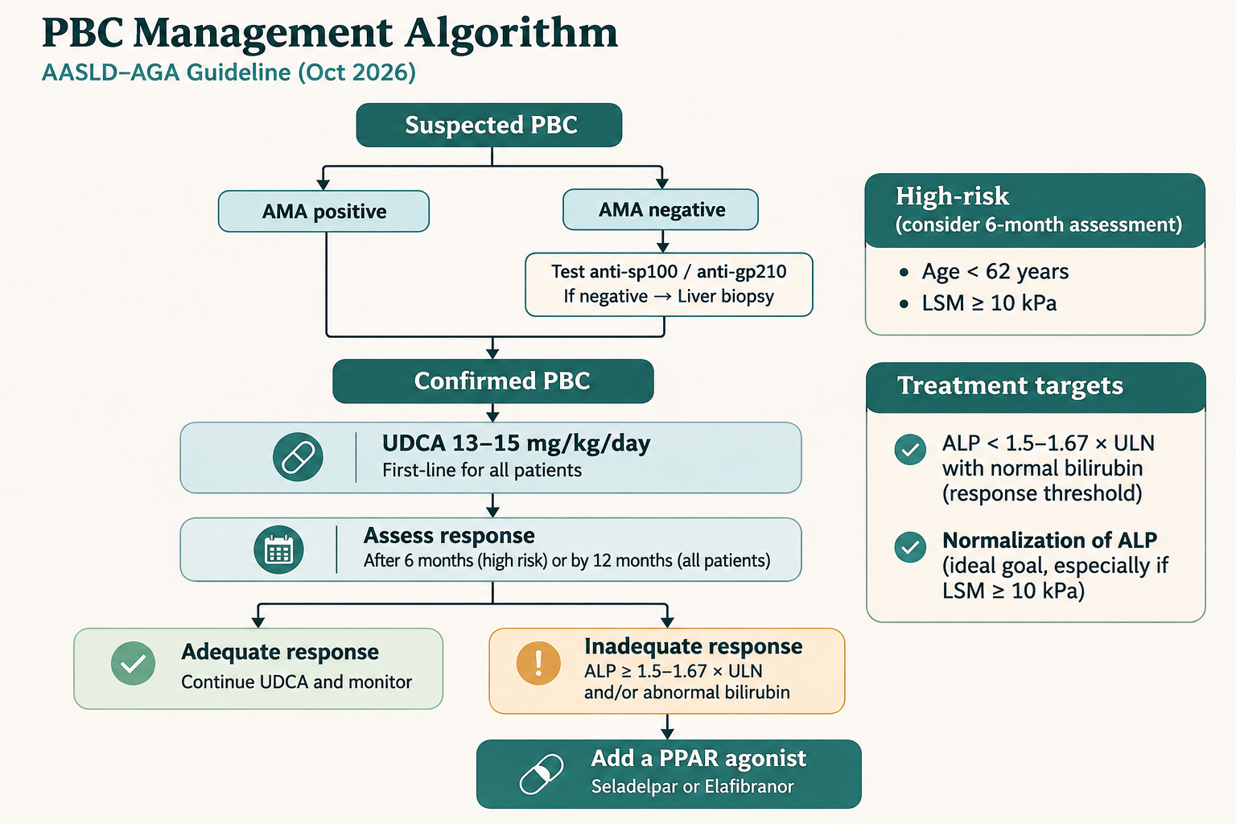

Slide 36
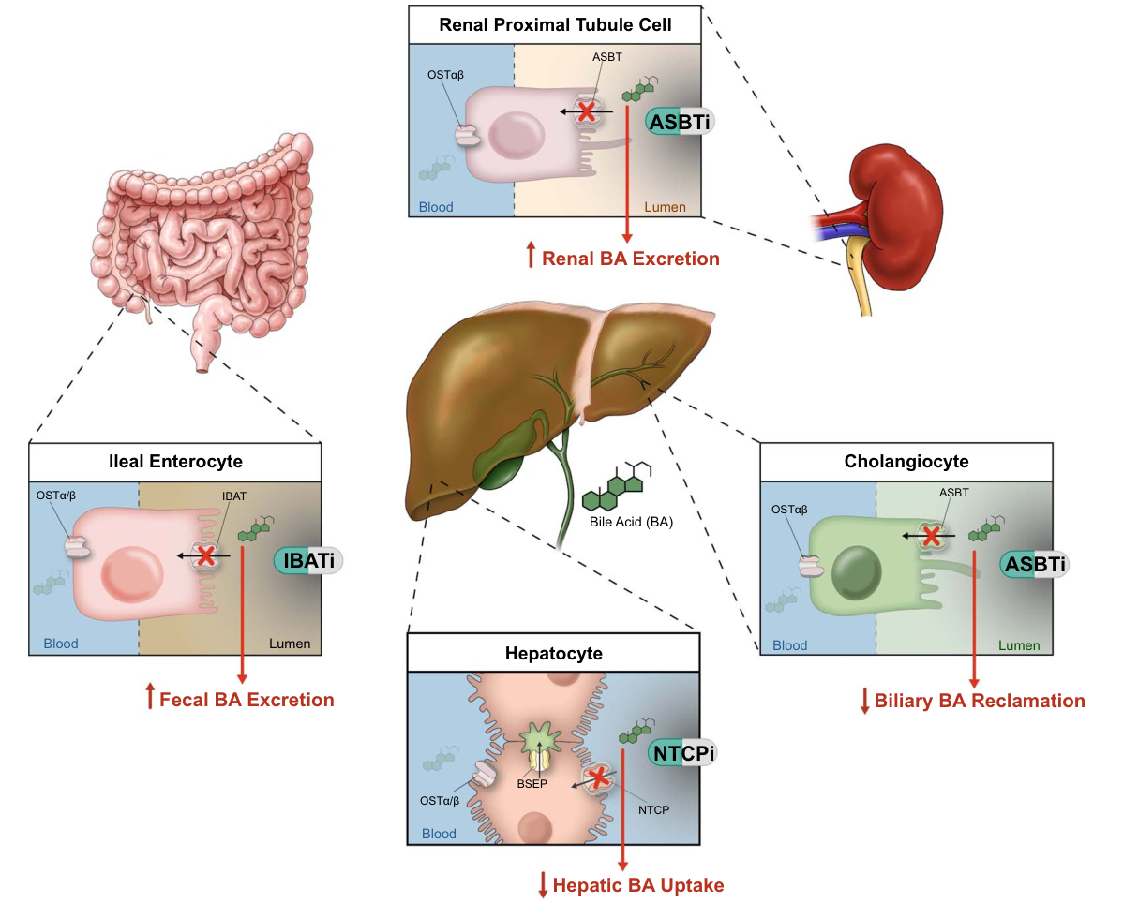
Bile acid transporters: established and experimental targets
Trauner M, Karpen SJ, Dawson PA. Benefits and challenges to therapeutic targeting of bile acid circulation in cholestatic liver disease. Hepatology. 2025 Oct 1;82(4):855-876

Slide 37
IBAT inhibitors in children with PFIC
Blocking ileal reuptake shrinks the bile acid pool reaching the liver
MARCH-PFIC · MARALIXIBAT · n = 93 · MEDIAN AGE 3
STATUS
Itch score, BSEP cohort
Serum bile acids, BSEP cohort
Odevixibat and maralixibat licensed for PFIC in many countries
−1.1
−187 µmol/L
vs placebo (95% CI −1.8 to −0.3)
vs placebo (95% CI −293 to −80)
Diarrhoea: 57% vs 20%, mostly mild to moderate
ADULT GENETIC DISEASE
No trials; benefit in milder adult disease is inferred, not shown
Miethke et al, Lancet Gastroenterol Hepatol 2024;9:620 (MARCH-PFIC; figures as reported by Healio) · Thompson et al, JHEP Rep 2026 (refs 129–132)
Notes:
MARCH-PFIC, published in Lancet Gastroenterology and Hepatology in 2024, randomised 93 children with PFIC and persistent pruritus, median age 3, to maralixibat or placebo. In the primary BSEP-deficiency cohort, the itch score fell by 1.1 points more than placebo (95% CI −1.8 to −0.3), and serum bile acids fell by 187 µmol/L more than placebo (95% CI −293 to −80). Across all PFIC subtypes the itch difference was −1.2. Diarrhoea, mostly mild or moderate, occurred in 57 percent versus 20 percent. These figures are as reported in the Healio summary of the paper; I did not open the full text. Thompson notes that randomised trials of both odevixibat and maralixibat in various PFIC types showed efficacy and tolerability, and that these drugs are now licensed for PFIC in many countries. Specific indications differ by jurisdiction and age; check the local label. The lower-right box is the critical restraint. Thompson writes that the adult diseases discussed are milder versions of those in the pivotal trials and that it is logical to think these drugs will work in milder phenotypes. That is reasoned opinion, not evidence, and the authors declare relationships with companies that market IBAT inhibitors. Paediatric endpoints and instruments also differ from adult ones. For our patient, an IBAT inhibitor would be off-label in the US unless she had PBC; the PBC-specific drug is on the next slide. Evidence status: paediatric efficacy supported by RCT; adult genetic cholestasis unproven.

Slide 38
Linerixibat for PBC itch
GLISTEN · n = 238 · 24 WEEKS · 97% ON UDCA
US LABEL · MARCH 2026
Fall in monthly worst-itch score (0–10)
Cholestatic pruritus in adults with PBC
Linerixibat
−2.86
Avoid in decompensated cirrhosis
Placebo
−2.15
Monitor liver tests and fat-soluble vitamins
Difference −0.72 (95% CI −1.15 to −0.28) · sleep −0.53
Separate from bile acid resins by 4 hours
Diarrhoea 62% vs 18% · stopped for adverse effects 14% vs 5%
Not approved for fibrosis or survival
Hirschfield et al, Lancet Gastroenterol Hepatol 2026;11:22–33 (GLISTEN) · LYNAVOY US prescribing information (FDA label 2026). Redrawn
Notes:
This replaces the first deck’s “under FDA review, outcome not checked”. Linerixibat, an IBAT inhibitor marketed as Lynavoy, is FDA-approved for the treatment of cholestatic pruritus associated with PBC in adults; the approval was announced in March 2026. The production brief gives 17 March; GSK’s announcement was dated 19 March. The label states initial US approval 2026. GLISTEN, Lancet Gastroenterology and Hepatology 2026: 238 adults with PBC and moderate to severe itch, 97 percent on UDCA, randomised to linerixibat 40 mg twice daily or placebo for 24 weeks. The monthly worst-itch score fell by 2.86 points with linerixibat and 2.15 with placebo, a difference of −0.72 (95% CI −1.15 to −0.28; p = 0.001). Sleep interference improved by 0.53 points more than placebo. Bars are drawn to scale. Two critical readings. First, the placebo response was large, and the mean placebo-adjusted benefit is modest on a 0 to 10 scale; some patients respond much better than the mean, but the average effect is not dramatic. Second, diarrhoea occurred in 62 percent versus 18 percent per the label, abdominal pain in 26 versus 10 percent, and 14 versus 5 percent stopped for adverse reactions. Label points: avoid in decompensated cirrhosis or prior decompensation; monitor liver tests; check vitamins A, D, E and INR; IBAT inhibitors carry a fracture signal; separate from resins by at least 4 hours. This is a symptom drug, not a disease-modifying one. SFDA status not verified. Evidence status: RCT, direct patient-reported benefit.

Slide 39
CHOLESTASIS: BEYOND BILE FLOW
3
2
Pruritus:
4
mechanisms
5
The biopsy
Adult genetic
and patterns
and treatment
Established and
cholestasis
emerging
therapeutics
1
What is
cholestasis
Take Home
Notes:
Transition slide 1 of 5. Same slide repeated between sections; the lit branch marks the topic that starts now. Order: What is cholestasis; The biopsy and patterns; Pruritus: mechanisms and treatment; Adult genetic cholestasis; Established and emerging therapeutics.

Slide 40
Take-home points
1
Treat cholestasis as a syndrome: find the cause before naming the disease.
2
Read the biopsy pattern together with serology and imaging.
3
Treat itch stepwise and reassess it at every visit; newer agents are available.
4
Test adults with 6 phenotypes that warrant it: the result can change treatment, surveillance and family counselling. (ABCB4 and ABCB11)
5
In PBC, reassess UDCA response by 6 to 12 months and escalate on risk, not on ALP alone.
Notes:
Take-home slide, dark theme to match the section-transition slides. Wording of the five points follows the revised set agreed in discussion. 1. Cholestasis is a syndrome, not a diagnosis: the work is finding the cause. 2. Biopsy pattern is read with serology and imaging, never alone. 3. Itch: stepwise approach (sequestrant, rifampicin, naltrexone, sertraline), reassess every visit. Newer agents add modestly; elafibranor missed its itch endpoint, linerixibat gave modest absolute reductions with frequent diarrhoea. 4. Genetic testing in adults with suggestive phenotypes: EASL 2024 links a result to treatment, surveillance and family counselling. 5. Per the 2026 AASLD/AGA PBC guideline: assess UDCA response at 6 to 12 months, earlier if LSM 10 kPa or more or age under 62; escalation is a conditional, low-certainty recommendation and a shared decision, with risk-based as well as threshold-based thinking.

