Slide 1

The Art of Negotiation
&
MASH

Slide 2
42-year-old man with obesity (BMI 33), type 2 diabetes, and hypertension.
Findings:
  Mild ALT/AST elevation (1.5× ULN)
  FIB-4: 1.9 → indeterminate range
  VCTE (FibroScan): 9.2 kPa → consistent with F2–F3 fibrosis
  CAP: 315 dB/m → steatosis grade 2
  HbA1c: 7.4%
  LDL: 3.2 mmol/L
Management discussion:
  Patient motivated for lifestyle modification but has failed sustained weight loss.
  Meets criteria for pharmacologic therapy.
Treatment is indicated
  Hospital formulary does not yet include Resmetirom
  GLP-1RA coverage restricted to diabetics with CV risk.

Slide 3
You will meet the senior administration for approval of Resmetirom
What will you do ?

Slide 4
The Negotiation Framework
Orchestrate
Frame
Diagnose
Anchor
BATNA
Concepts adapted from “Negotiation Strategies: Creating and Maximizing Value Program,” Columbia Business School (2024).
Notes:
Orchestrate (who, where and how)

Slide 5
Orchestrate
Who
Where/when
How
What

Slide 6
Frame — How You Shape the Story
Framing decides whether people see a budget request or a health strategy.
You will shape whether this is seen as another burden, or as the next opportunity to lead
 | Impression | Your Frame
Economic | Cost driver | Cost avoidance and predictability
Clinical | Fatty liver niche | Major metabolic disease, treatable
Public Health | Lifestyle issue | Population-level epidemic along with T2DM
Strategic | Single drug decision | Alignment with national prevention goals

Slide 7
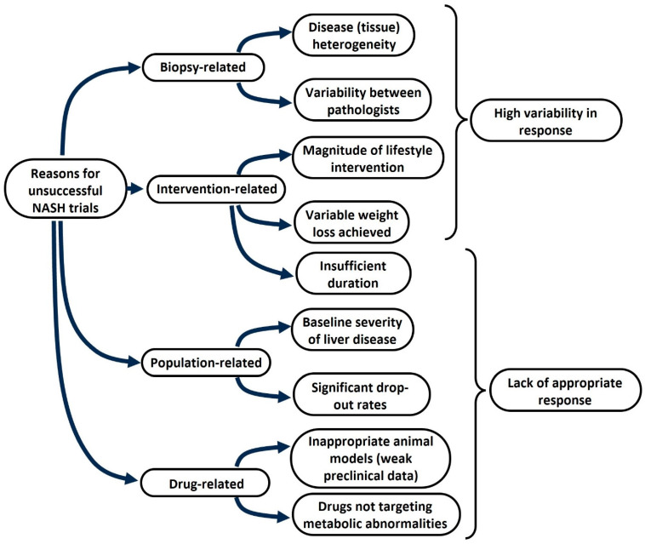
Why do we struggle with MASH treatment ?
Zannad F, et al. J Intern Med. 2024 Jul
Notes:
Lifestyle intervention reduces statistical separation between placebo and intervention

Slide 8
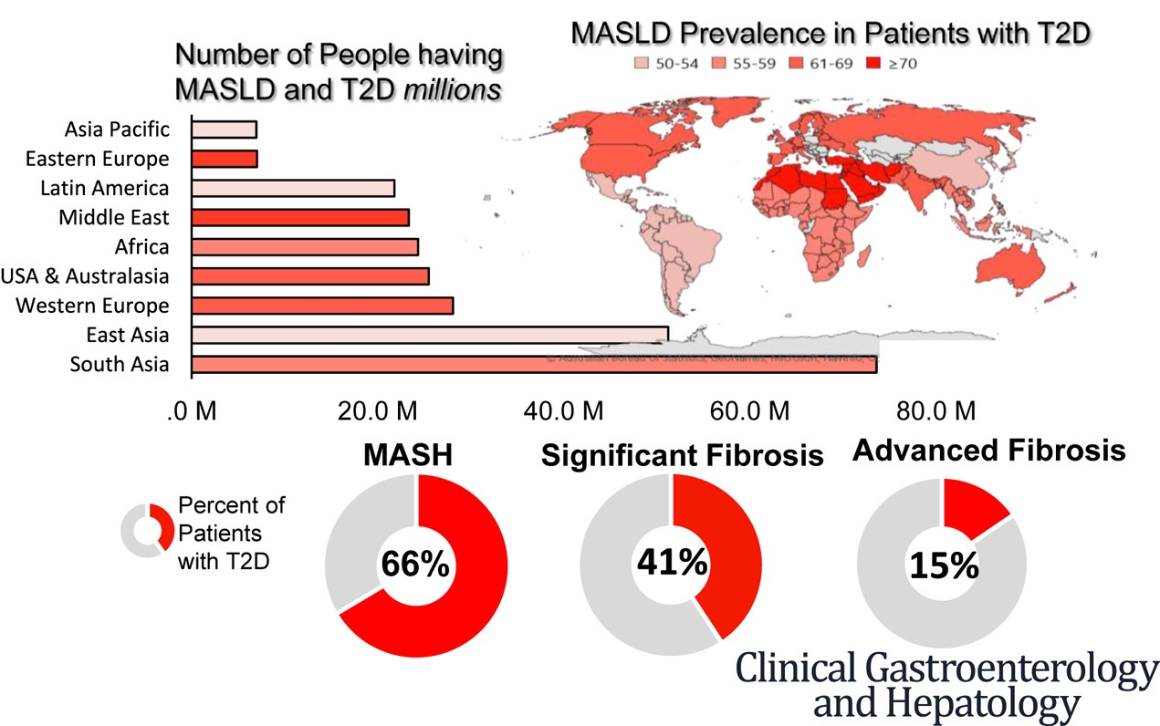
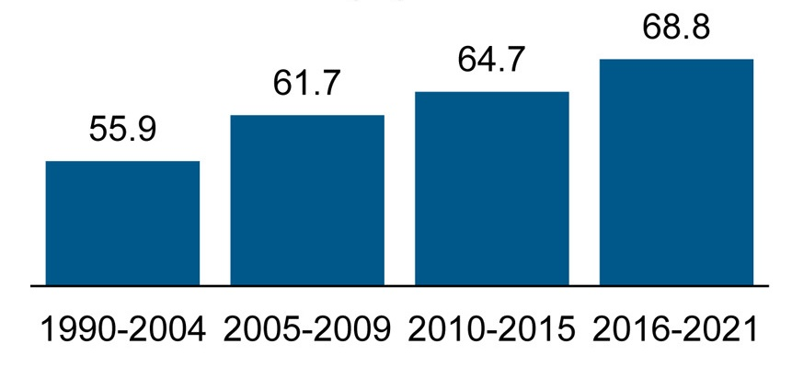
Hand in hand with Diabetes
Prevalence of MASLD T2DM
MASLD
≥ F2
≥ F3
Younossi, Zobair M. et al. The Global Epidemiology of Nonalcoholic Fatty Liver Disease and Nonalcoholic Steatohepatitis Among Patients With Type 2 Diabetes. Clinical Gastroenterology and Hepatology, October 2024

Slide 9
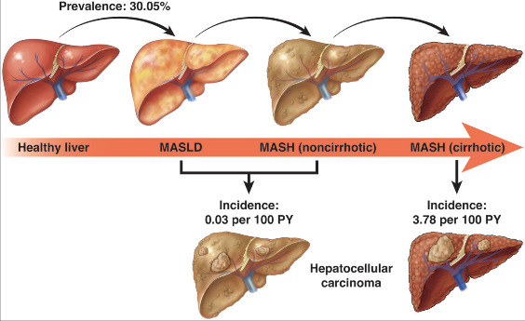
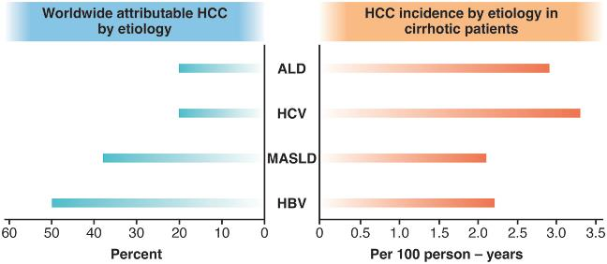
Worldwide hepatocellular carcinoma (HCC) epidemiologic scenario by etiology. ALD, alcohol-related liver disease; HBV, hepatitis B virus; HCV, hepatitis C virus; MASLD, metabolic dysfunction–associated steatotic liver disease.
Clinical Gastroenterology and Hepatology Volume 22, Issue 9p1774-1789. September 2024

Slide 10
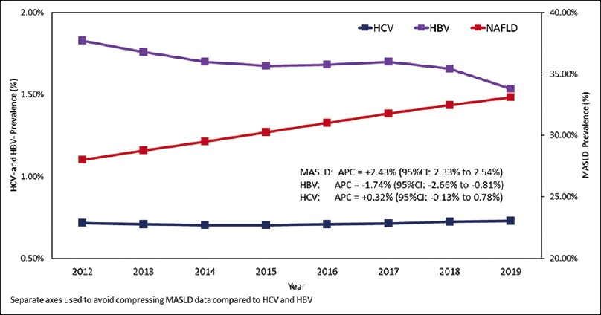
MASLD-related liver deaths (from cirrhosis and cancer) in KSA are increasing ~1.15% per year
The burden of metabolic dysfunction-associated steatotic liver disease and viral hepatitis in Saudi Arabia Saudi Journal of Gastroenterology 30(5):p 310-318, Sep–Oct 2024

Slide 11
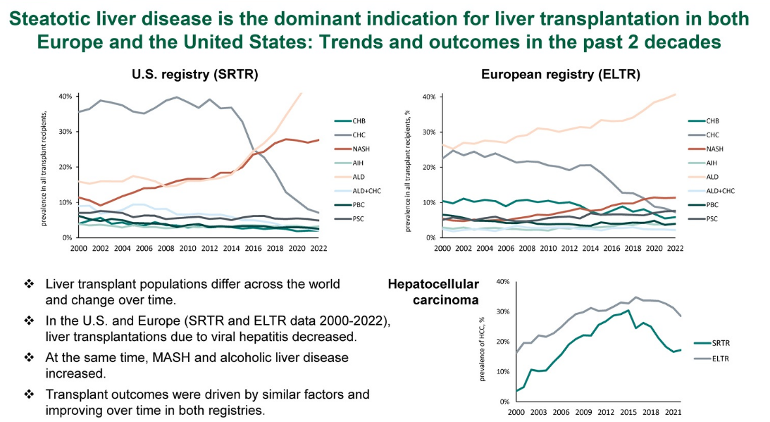
Younossi, Zobair. Steatotic liver disease is the dominant indication for liver transplantation in both Europe and the United States: Trends and outcomes in the past 2 decades. Liver Transplantation, July 18, 2025.

Slide 12
Diagnose
Map each stakeholder’s priorities:
  safety, cost, quality, predictability.
Anticipate what’s not said
  fears, constraints, internal pressures.
Speak in their terms
  audit-ready, capped, KPI-linked.
Treat objections as data gaps, not resistance.

Slide 13
Stakeholder | What They Care About | What They Fear | What You Can Offer
Pharmacy | Safety, formulary simplicity, audit readiness | Uncontrolled use, adverse events | Strict criteria, stop rules, monitoring
Finance/Budget | Cost neutrality, predictability | Budget creep, hidden costs | Pilot with cap + 6-month review
CMO / Quality | Institutional KPIs: readmissions, LOS, outcomes | Unproven benefit, regulatory scrutiny | Align with quality metrics, national liver strategy
Procurement / Payer | Contract terms, reimbursement efficiency | Late invoices, price volatility | Volume cap, measurable ROI
Hepatology peers | Credibility, consistency | Perception of bias or hype | Shared protocol, transparent results

Slide 14
Is there a risk of appearing to neglect a group of patient (F0-1)?
Mortality Outcomes by Fibrosis Stage in Nonalcoholic Fatty Liver Disease: A Systematic Review and Meta-analysis. Clin Gastroenterol Hepatol. 2023 Apr;21(4):931-939.e5.

Slide 15
Resmetirom Phase 3
Is this even effective ?
A Phase 3, Randomized, Controlled Trial of Resmetirom in NASH with Liver Fibrosis
MAESTRO-NASH February 7, 2024 N Engl J Med 2024;390:497-509

Slide 16
Will we need a lot of liver biopsy? And will we manage the extra load on pathology department ?

Slide 17
Its complicated.
2018 – First FDA draft guidance (still current):
  Target population: F2–F3 MASH, NAS ≥4.
  Regulatory pathways:
    Full approval → clinical outcomes.(decompensation, transplant free survival…etc)
    Accelerated approval → histology (fibrosis/NASH resolution).
2019–2021 – Biopsy controversy escalates:
  Resmetirom Phase II (2019) showed promise but highlighted biopsy issues.
  Seladelpar (2019) stopped early due to misinterpretation of biopsy slides.
  EMMINENCE Trial (2020) → 25% misclassified at entry, confirming high inter-/intra-reader variability.
  FDA response (2021): mandated masked consensus biopsy review + adjudication committees.
2023 – REGENERATE reanalysis: 3-pathologist consensus + digital pathology reduced placebo bias → became Phase 3 standard.
2024 – Resmetirom approved (historic first MASH drug) via accelerated approval:
  FDA did not require biopsy for diagnosis → shift toward NIT-guided patient selection.
  Signals future direction: NITs + AI pathology to replace biopsy endpoints.
Harrison SA, et al. J Hepatol. 2024 Nov
Lonardo A, et al. Metabolites. 2024 Jan

Slide 18
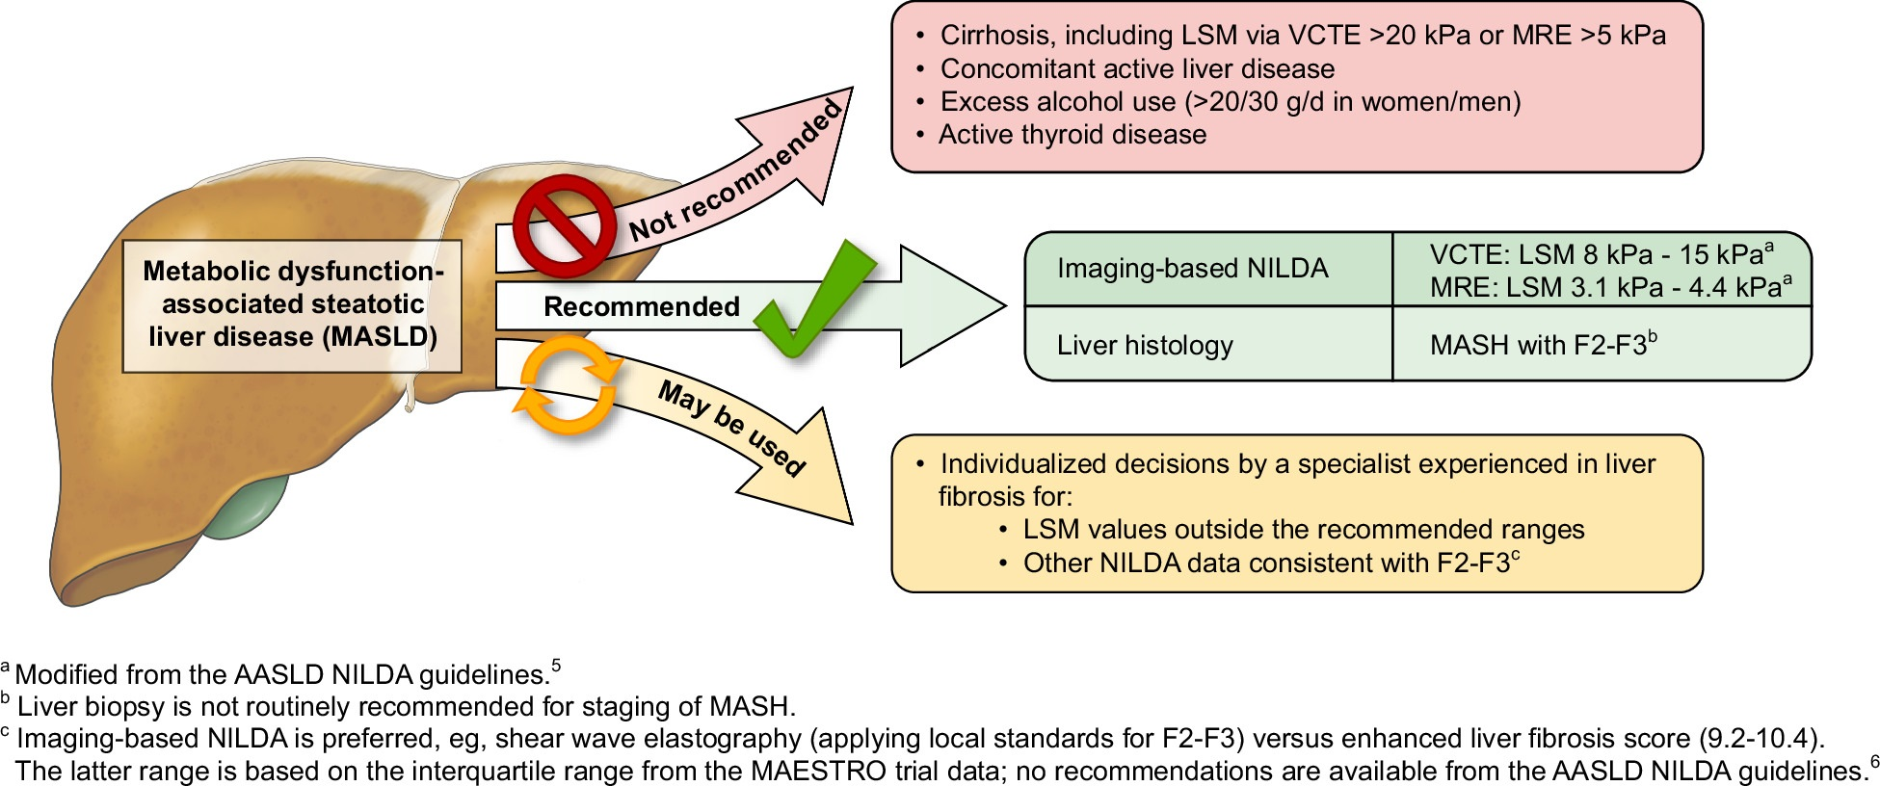
Selection of Patients for Resmetirom Therapy
Chen, et al. Resmetirom therapy for MASLD: October 2024 updates to AASLD Practice Guidance. Hepatology 81(1):p 312-320, January 2025.

Slide 19
But is Fibroscan really reliable ?
60%
73%
74%

Slide 20



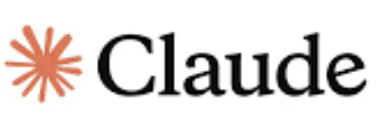


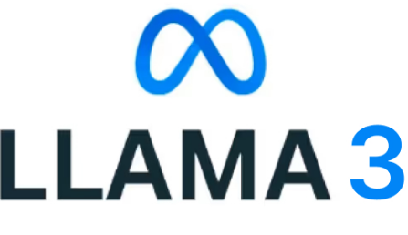
What is the solution ?

Slide 21
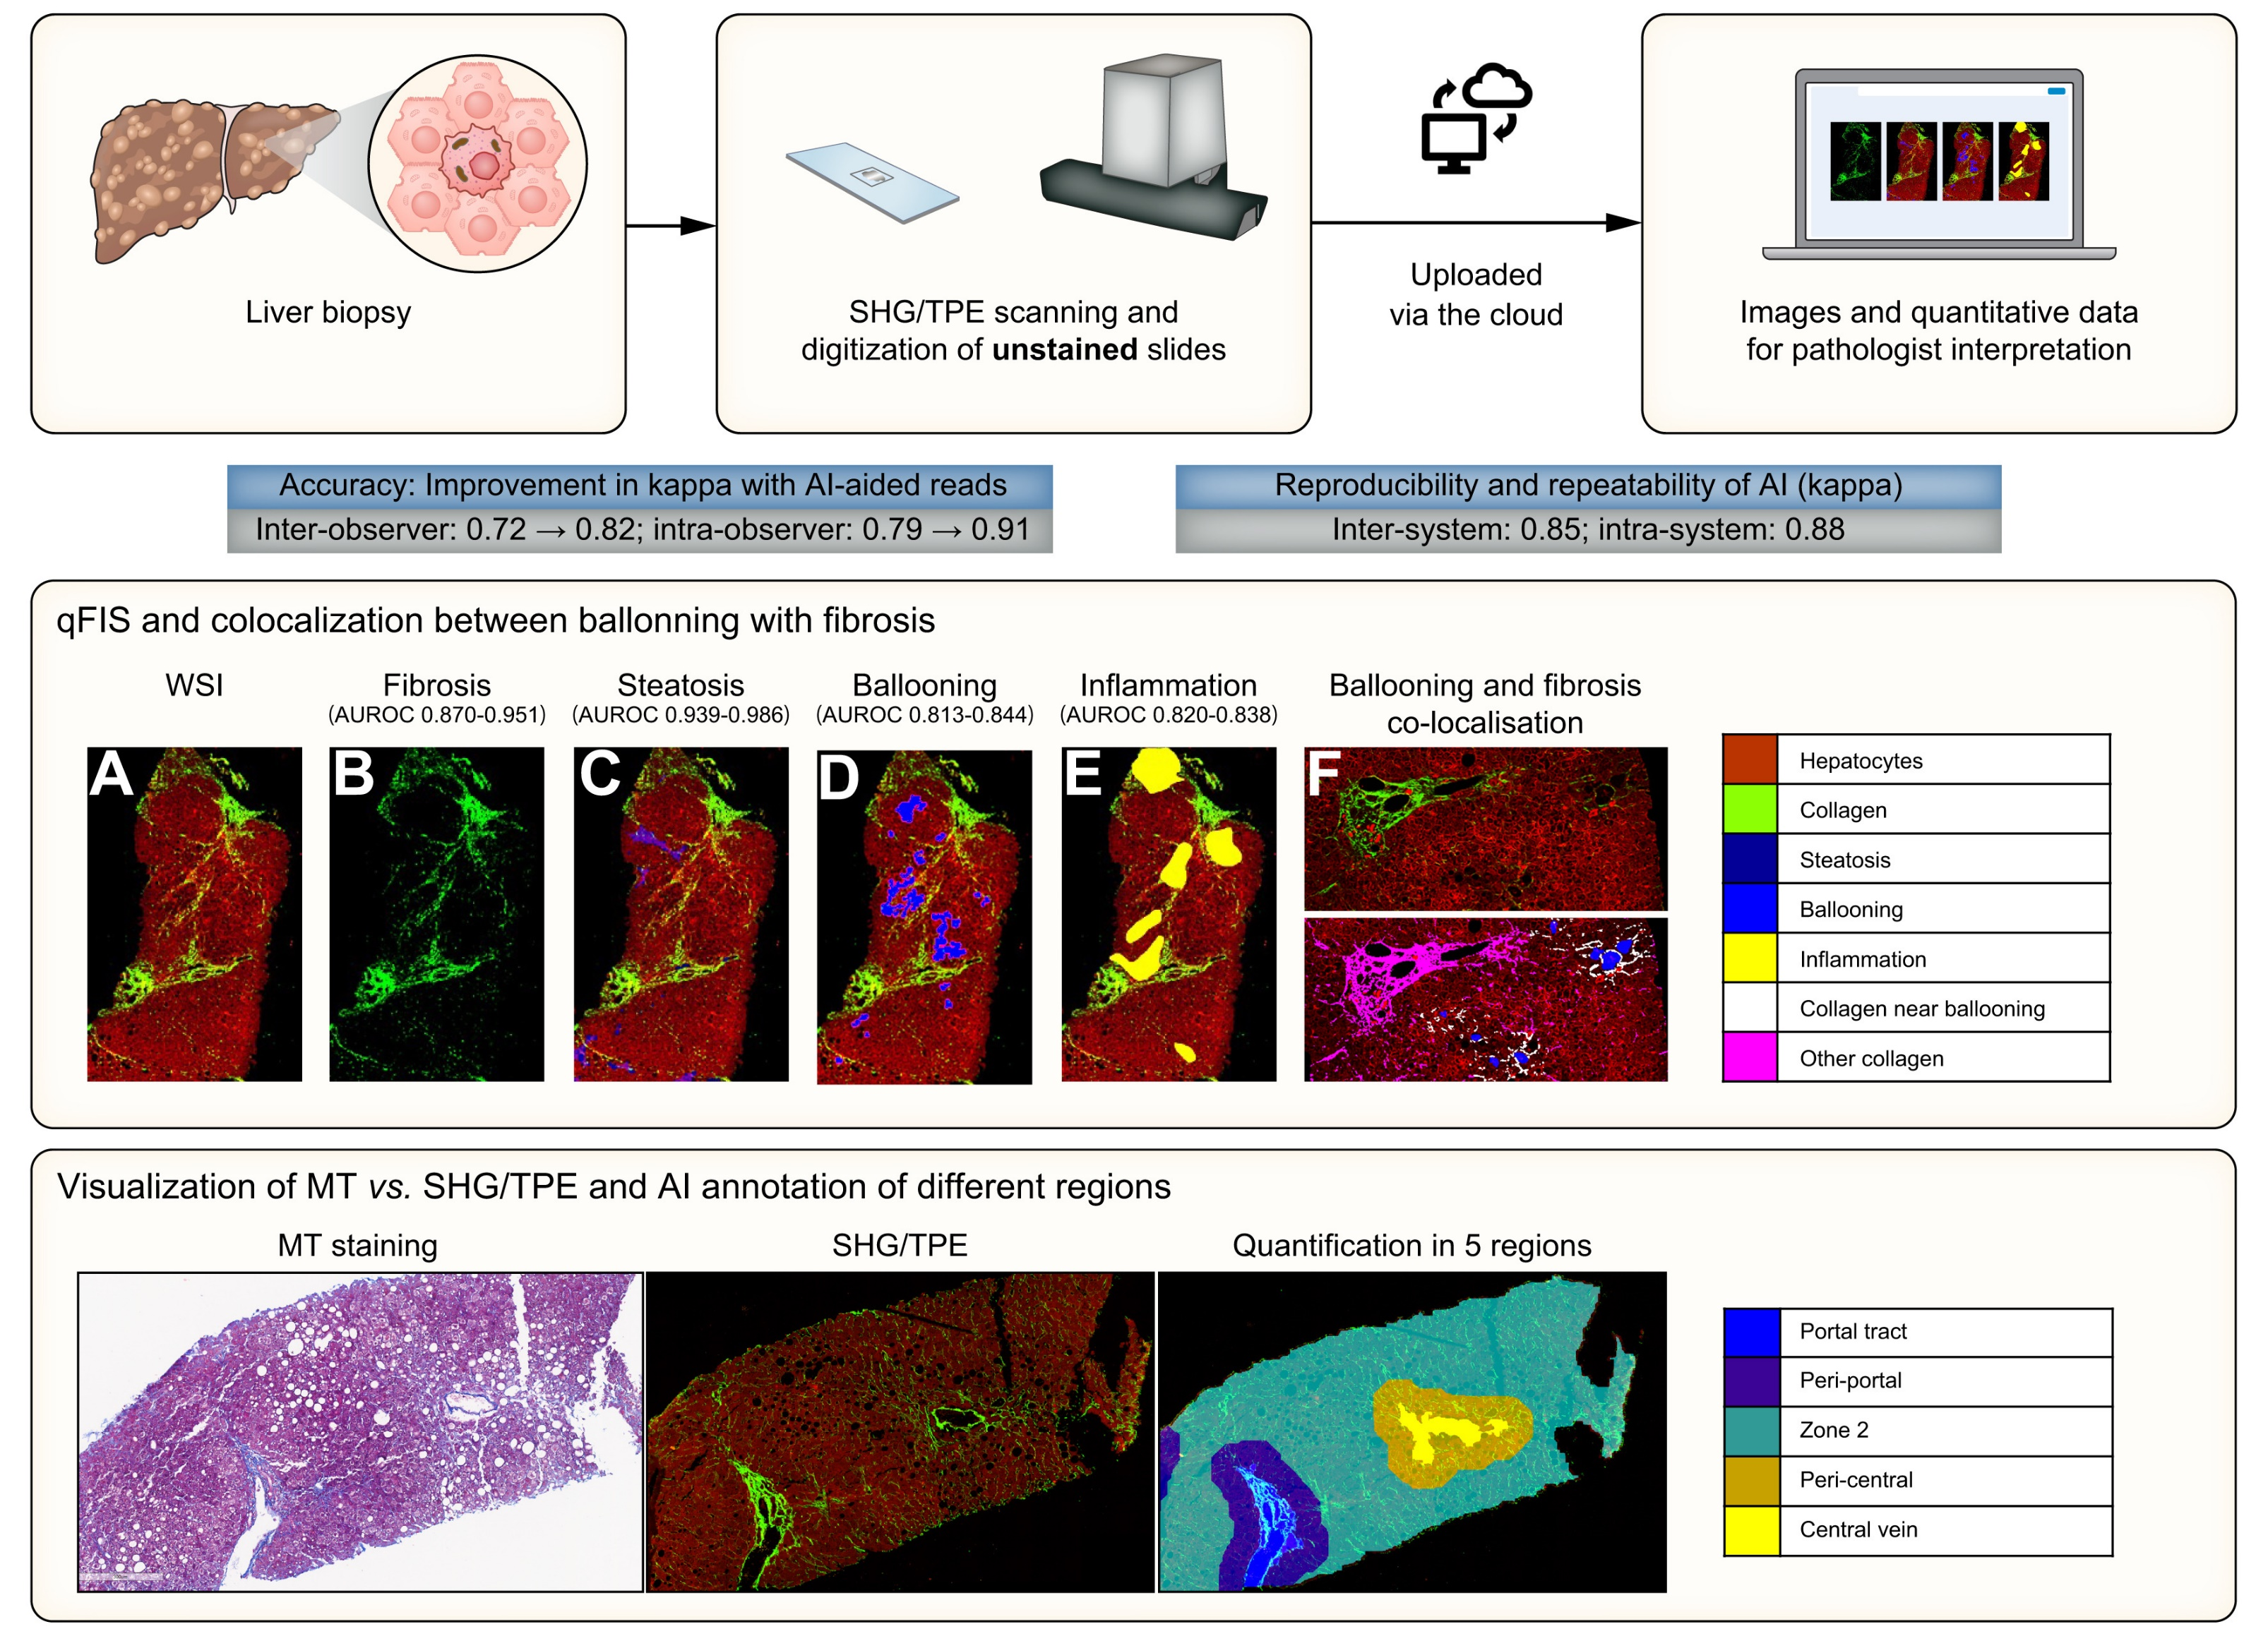
Artificial intelligence-assisted digital pathology for non-alcoholic steatohepatitis: current status and future directions Ratziu, Vlad et al. Journal of Hepatology, p335-351 February 2024

Slide 22
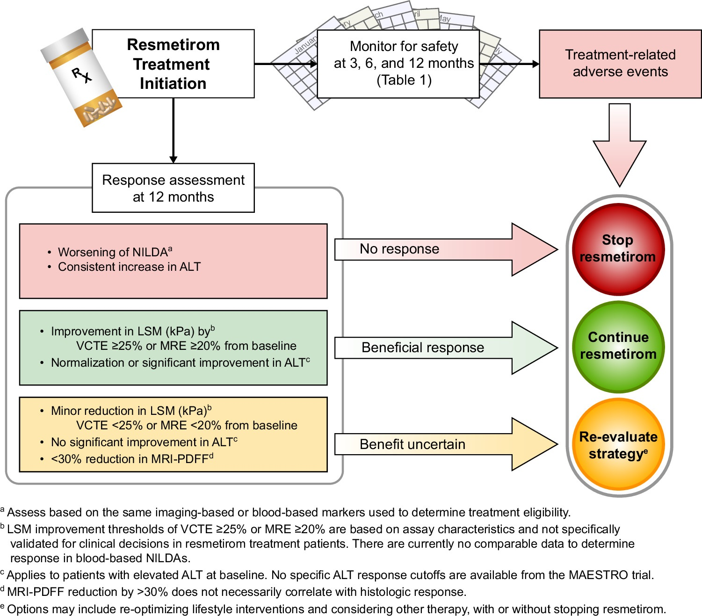
But how will we follow and assure benefit ?
Chen, et al. Resmetirom therapy for MASLD: October 2024 updates to AASLD Practice Guidance. Hepatology 81(1):p 312-320, January 2025.

Slide 23


The cost will be difficult to explain to the board
85,000 SAR/ year
600,000 SAR/ Transplant
65,000 / year follow up cost

Slide 24

Anchor
You have the data:
Treating at-risk MASH early (Resmetirom + structured follow-up) will save millions in cirrhosis and transplant costs.
You know the EDMA has the financial cost of the of the medication.
If it is up to you, who should start to address
the issue of cost ?

Slide 25
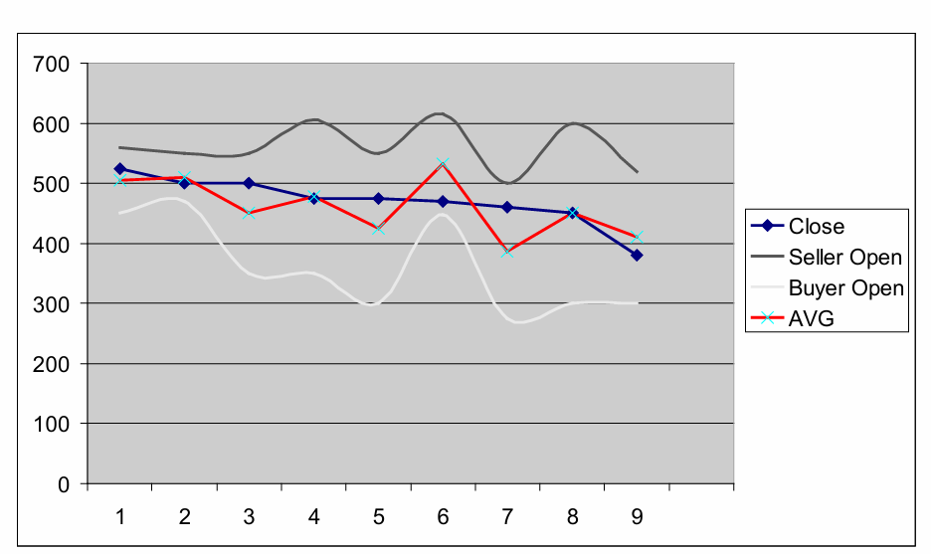
Galinsky, A. D., & Mussweiler, T. (2001). First offers as anchors: The role of perspective-taking and negotiator focus. Journal of Personality and Social Psychology, 81(4), 657–669.

Slide 26
Anchor
“Always start — but start with value.”
“Your first reference point shapes the rest.”
“Anchor early. Anchor smart.”

Slide 27
BATNA (Best Alternative to a Negotiated Agreement)
Your Plan B, not your threat.
Keep it private; it gives you calm and control.
Diagnose their BATNA, if any — what happens to Pharmacy, Finance, or Quality if they say no.
The stronger your BATNA, the less desperate your tone — and the more persuasive your ask.

Slide 28

Your BATNA
Zone of possible agreement
Your Dream
Negotiation Landscape
Their Dream
Their BATNA

Slide 29
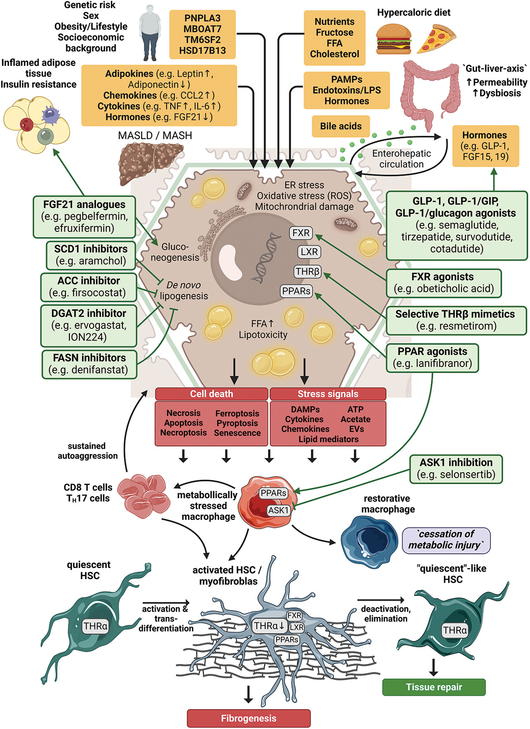
Puengel T, Tacke F. Pharmacotherapeutic options for MASLD. Expert Opin Pharmacother. 2024 Jun;25(9):1249-1263

Slide 30
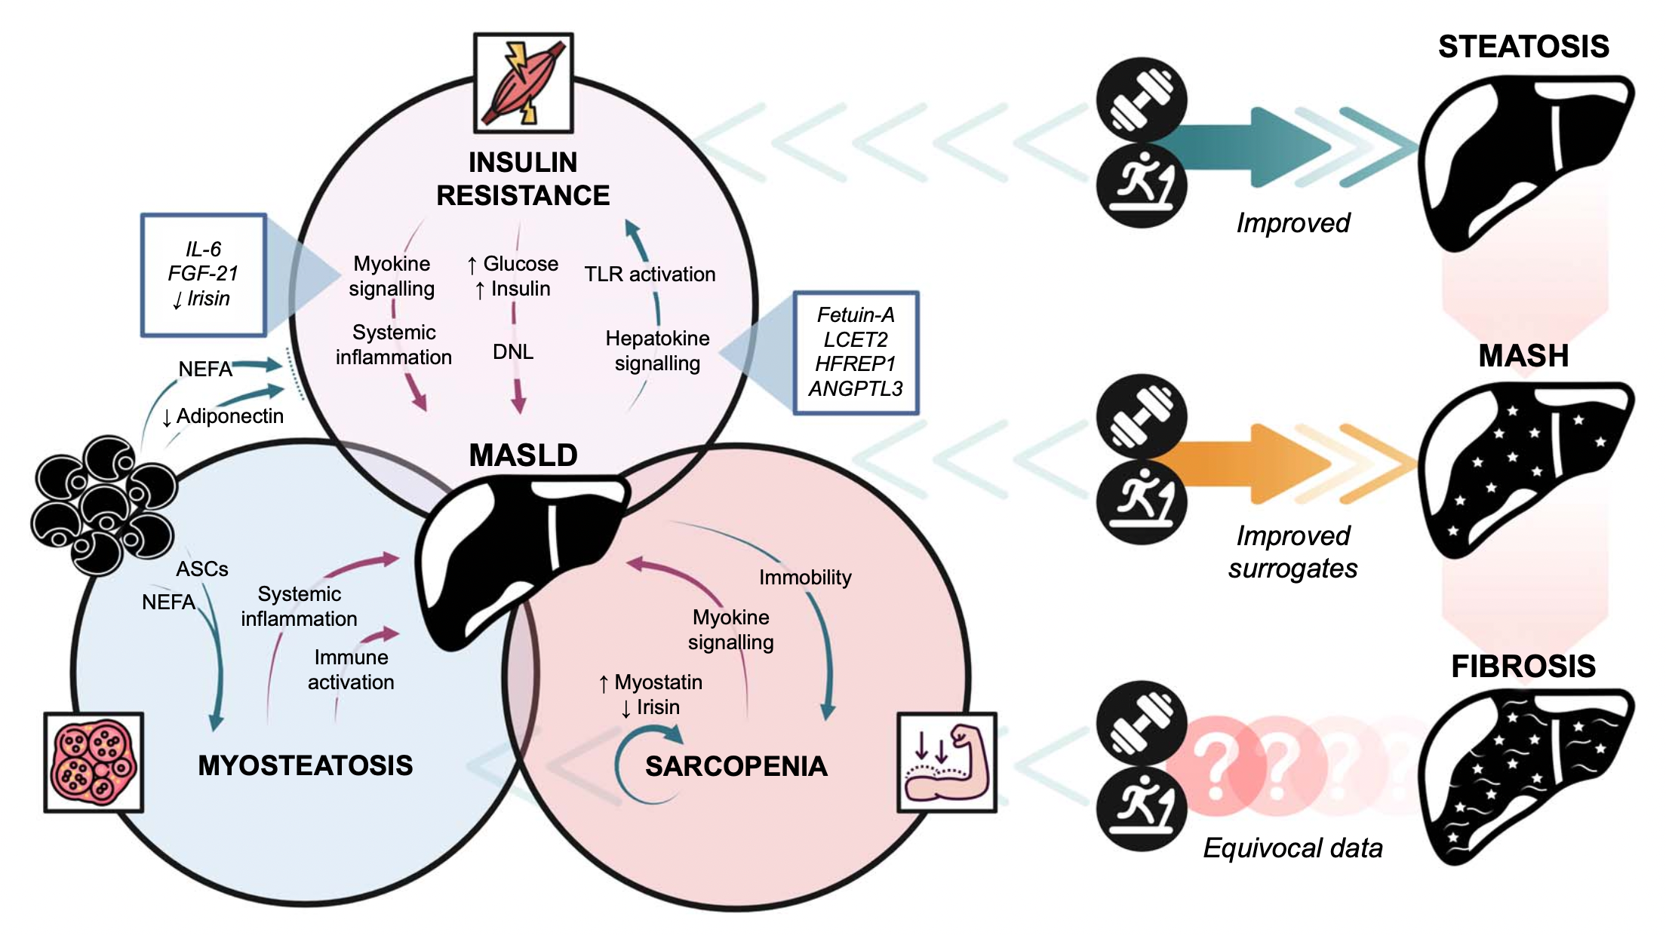
Exercise improves steatosis and markers of fibroinflammation
Marjot T. et al. Hepatology Communications 2025

Slide 31
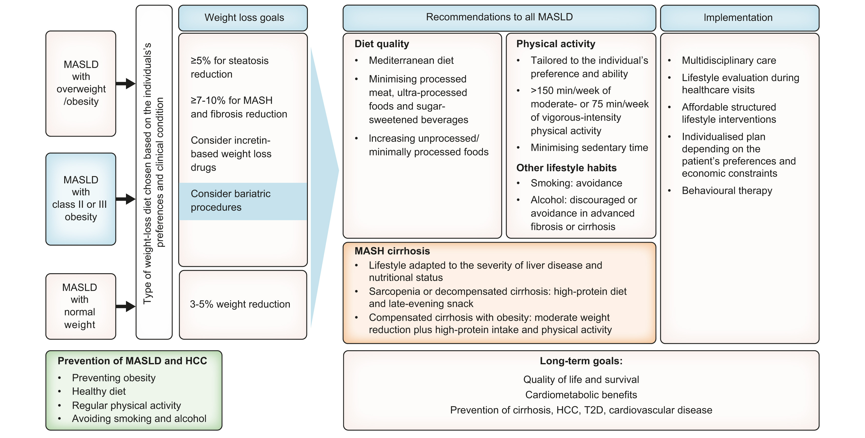
EASL–EASD–EASO Clinical Practice Guidelines on the management of metabolic dysfunction-associated steatotic liver disease (MASLD) 2024 Journal of Hepatology, Volume 81, Issue 3, 492 - 542

Slide 32
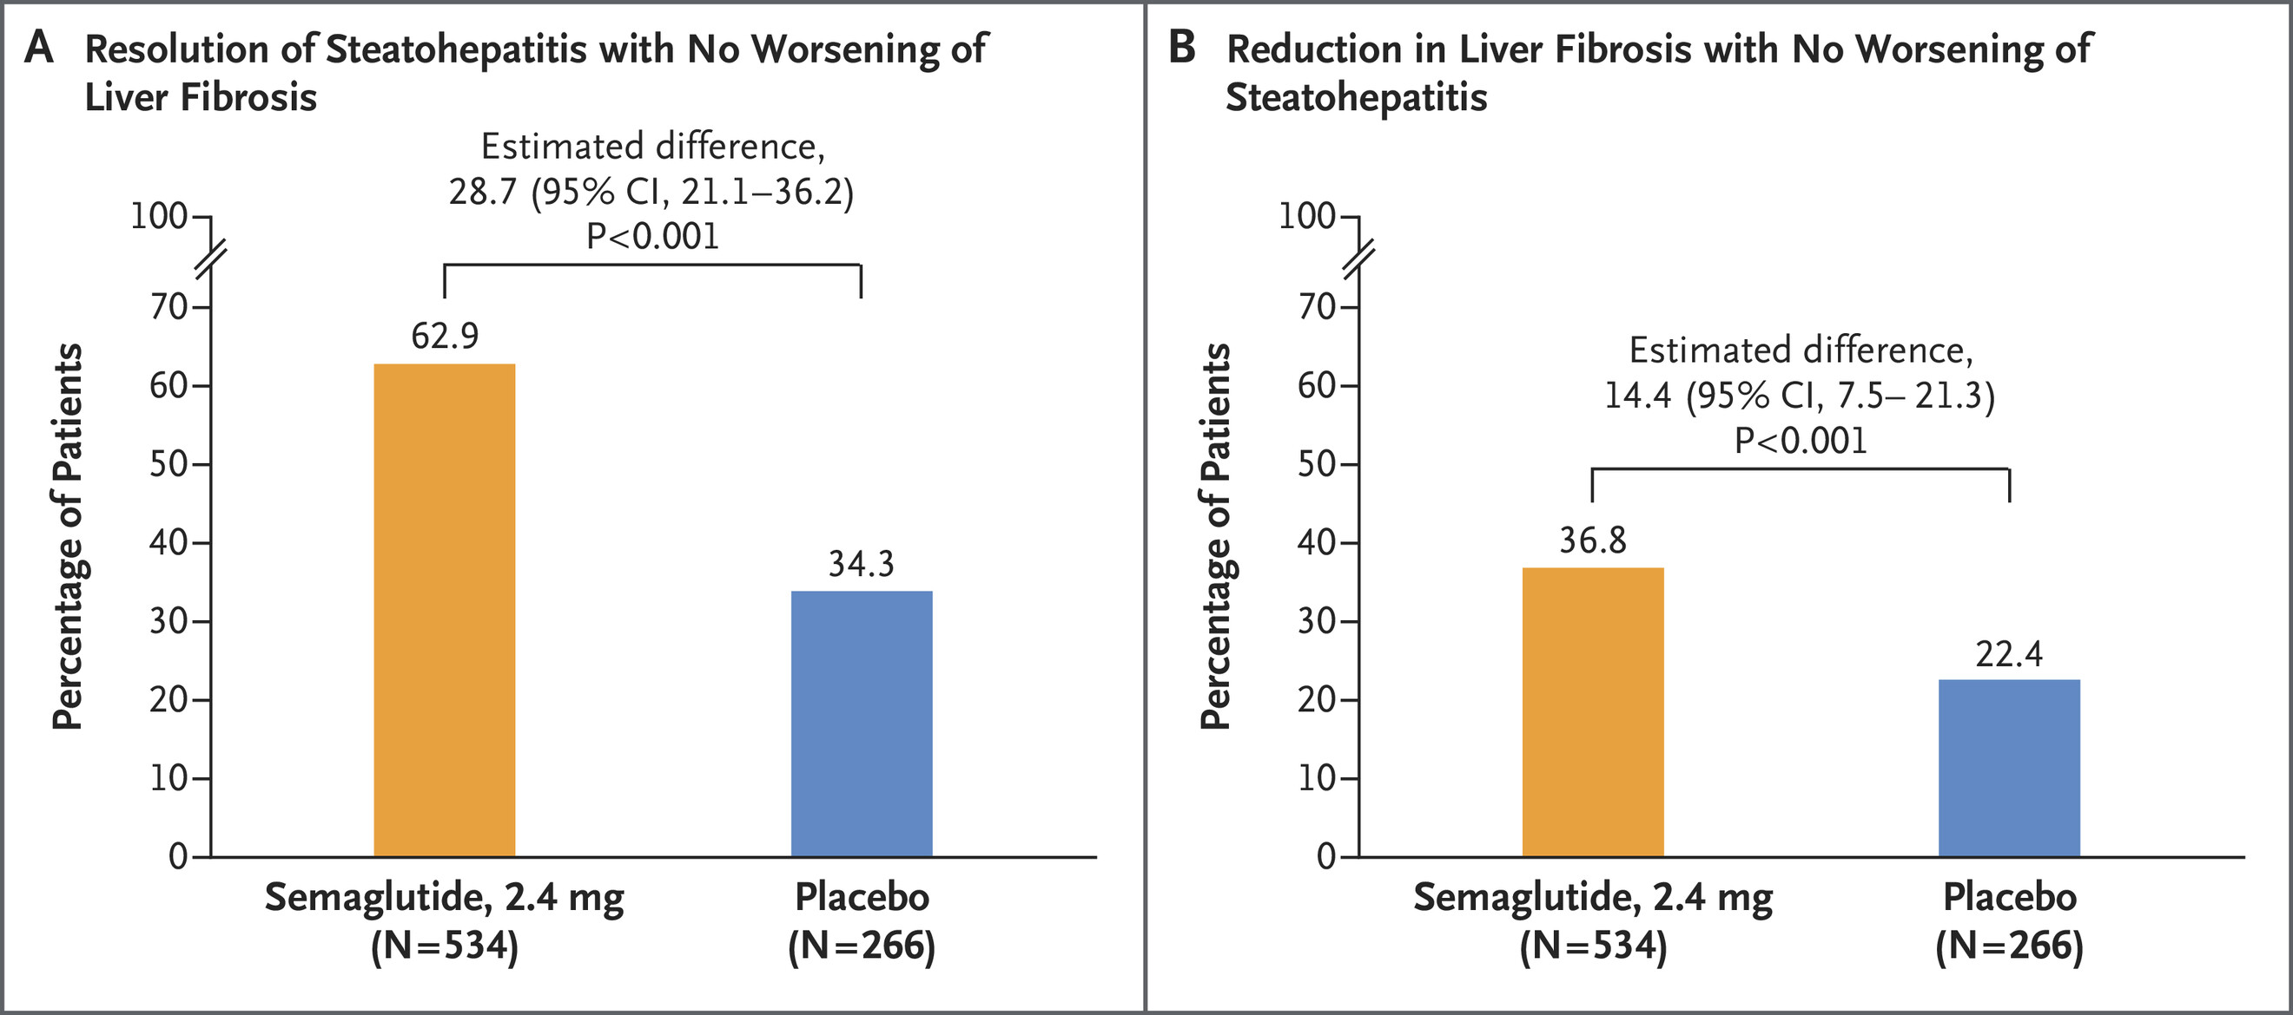
Access Semaglutide as BATNA
N Engl J Med 2025;392:2089-2099 DOI: 10.1056/NEJMoa2413258

Slide 33
FGF21
Henriksson & Andersen. Front Endocrinol 2020

Slide 34
Efruxifermin
Harrison et al. Lancet GH 2023

Slide 35
Cirrhosis
Noureddin et al. NEJM 2025. May 9, 2025

Slide 36

When No Means “Not Yet”
You only see part of the picture — assume there’s more behind the decision.
Learn to listen without defending.
Negotiate in good faith — and look for the good faith in others.
Every “no” is a chance to learn, to grow, and to quietly influence what comes next.

Slide 37
1.Orchestrate
2.Frame
3.Diagnose
4.Anchor
5.BATNA
Understand your leverage and gaps
choose wisely when how and where
A must for you and hide it
Identify theirs and leverage it
Win and/or Grow
Avoid “it is very clear, and the data speak for itself”
Frame the data to align with their priorities
Take the initiative
Be assertive but reasonable
What cant they say? or are embarrassed to say
Look for a win-win when possible

Slide 38
Thank you

