Slide 1
IM Board Review
بسم الله الرحمن الرحيم
Gastroenterology and Hepatology
Abdullah Khathlan

Slide 2
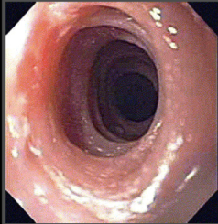

21 year old man with history of progressive dysphagia, mainly to solids. With history of repeated attacks of food impaction.
He has strong personal and family history of atopy.
He underwent gastroscopy and his esophagus showed
this picture. Which is true ?
It has very clear temporal relation with hypereosinophilic syndrome
Diagnosis require biopsies with at least 50 eosinophils per high power field .
This is a well known pre-malignant condition
PPI are first line of therapy for inducing and maintaining remission
Systemic steroids are first line therapy.

Slide 3
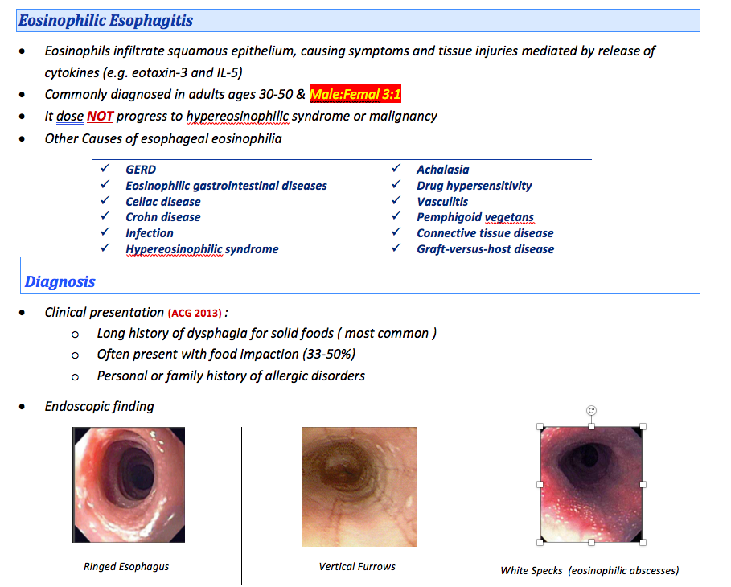

Slide 4
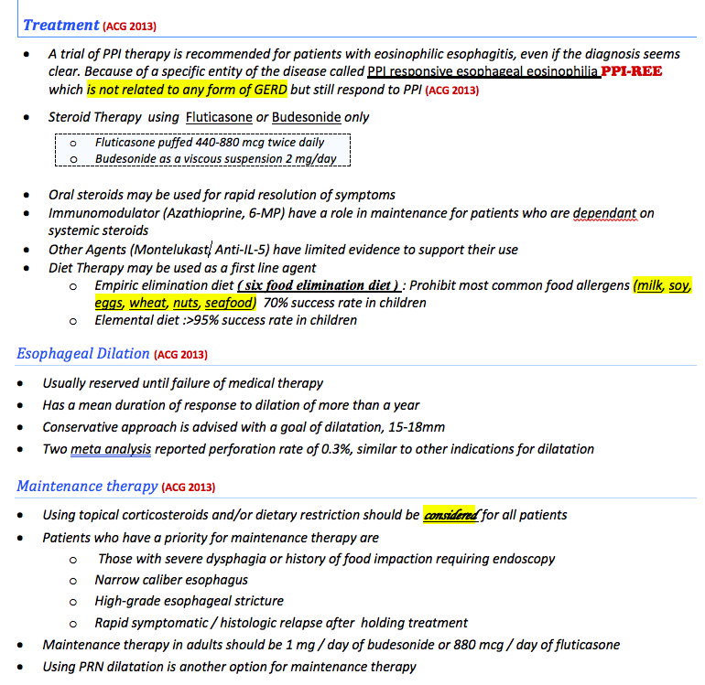

Slide 6
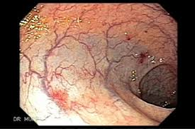
78 year old male admitted with recurrent attacks of black tarry stool.
Clinically he was pale, with ESM on cardiac exam, but no other abnormalities. His gastroscopy was unremarkable, as well as his clonosocopy.
Hormonal therapy is highly effective
No role for endoscopic therapy
Mechanical destruction of vWF may increase the chances of bleeding
Thalidomide is absolutely contraindicated in such patient
CT Angio did not reveal the the source of bleeding, and RBC scan identified multiple source of bleeding . On Capsule endoscopy, multiple lesions were identified
Which is correct in regard to the management

Slide 7
Gastrointestinal Angiodysplastic Lesions
(Am J Gastroenterology 2014 systematic review and meta-analysis)
Endoscopic therapy
Effective for controlling the bleeding. But with high recurrence rate. It reached 45% in patients with small bowel GIADs and 35% if the GIADs are in other locations.
Hormonal therapy
ineffective, with rebleeding occurring at a similar rate compared with placebo.
Somatostatin analogs
Sandostatin 10 mg was used in some trials, or octreotide.
It had an odds ratio to stop bleeding of 14.5 and reduction of transfusion of 0.55.

Slide 8
Antiangiogenics
Studies of thalidomide ( 100mg OD) vs iron demonstrated superiority of thalidomide in reducing the transfusion requirements. and although 70% of patients had side effects of thalidomide. most of these adverse events are mild.
Surgical therapy
Heyde's syndrome: GI bleeding from GIADs in patients with aortic stenosis secondary to the destruction of vWD.
AVR restores the vWF to its normal values and reduce the bleeding from GIADs. The results on small patients were very impressive > 80% never rebleed.

Slide 9
46 year old female admitted with abdominal pain in the epigastrium that is radiating to the back with nausea and vomiting. Clinically was hypotensive and with fever and decrease level of consciousness. She also was noticed to be jaundiced.
Found to have WBC of 20,000 ALT 160, AST of 120 Bilirubin of 80 Lipase of 4000
U/S shows gallbladder with multiple stones with CBD that is 8 mm with no CBD stones.
The patient is started on aggressive hydration and antibiotics.
The best next step for her management will be:
MRCP
Percutaneous cholecystostomy
Urgent Laparoscopic Cholecystectomy
ERCP
Continue with the supportive care

Slide 10
Indications for ERCP in setting of GB stones
Very strong | Strong | Moderate
CBD stone on transabdominal US Clinical ascending cholangitis Bilirubin > 4 mg/dL | Dilated CBD on US ( >6 mm with GB in situ) Bilirubin level 1.8-4 mg/dL | Abnormal liver biochemical test other than bilirubin Age older than 55 y Clinical gallstone pancreatitis
Direct ERCP: any Very strong or both strong |  | Otherwise EUS or MRCP first
Urgent ( within 24 Hrs ) | Early ( within 72hrs )
Cholangitis | Severe Pancreatitis Dilated CBD or CBD stone Jaundice

Slide 11
Patient post acute necrotizing pancreatitis. After receiving the appropriate management, his condition improved and was discharged from the hospital.
Currently, he is visiting you in the clinic and looks relatively well and with no major complain. He is tolerating orally and has no fever. Labs are back to baseline except for Amylase of 220.
The CT scan of the abdomen reveals a large area of necrosis in the head and the body of the pancreas with some free fluid around the area.
The best next step for his management will be:
Continue conservative management
Start prophylactic oral antibiotics
EUS guided drainage of the fluid
Keep him NPO and start home TPN
Surgical referral

Slide 12
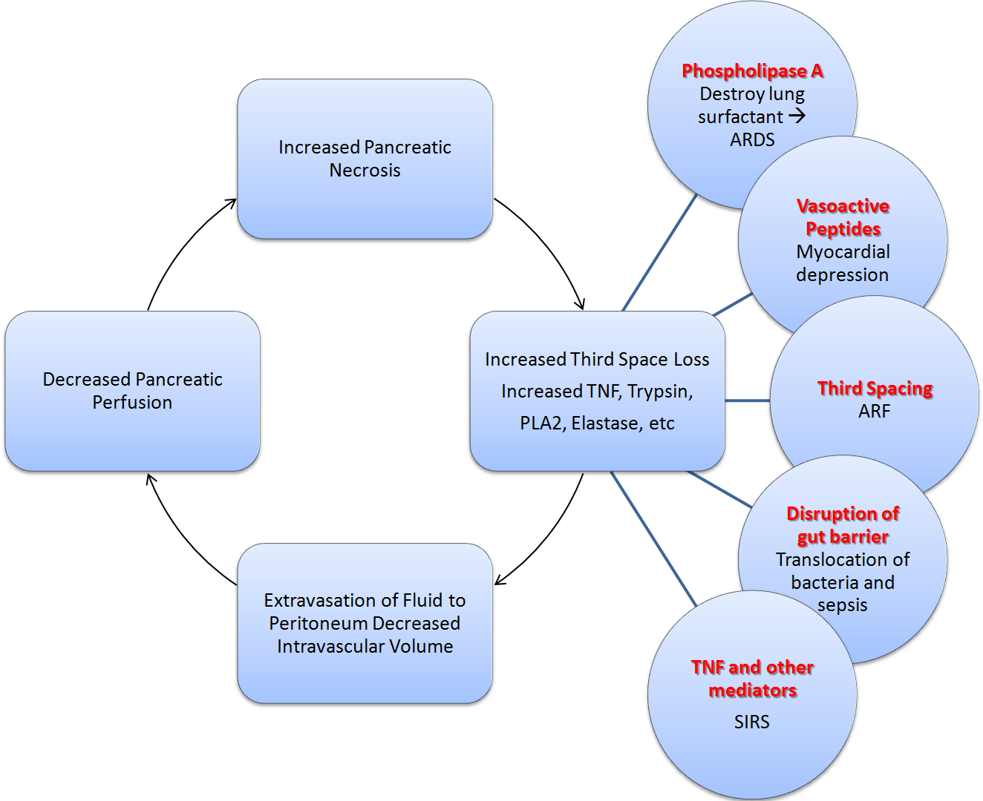

Slide 13
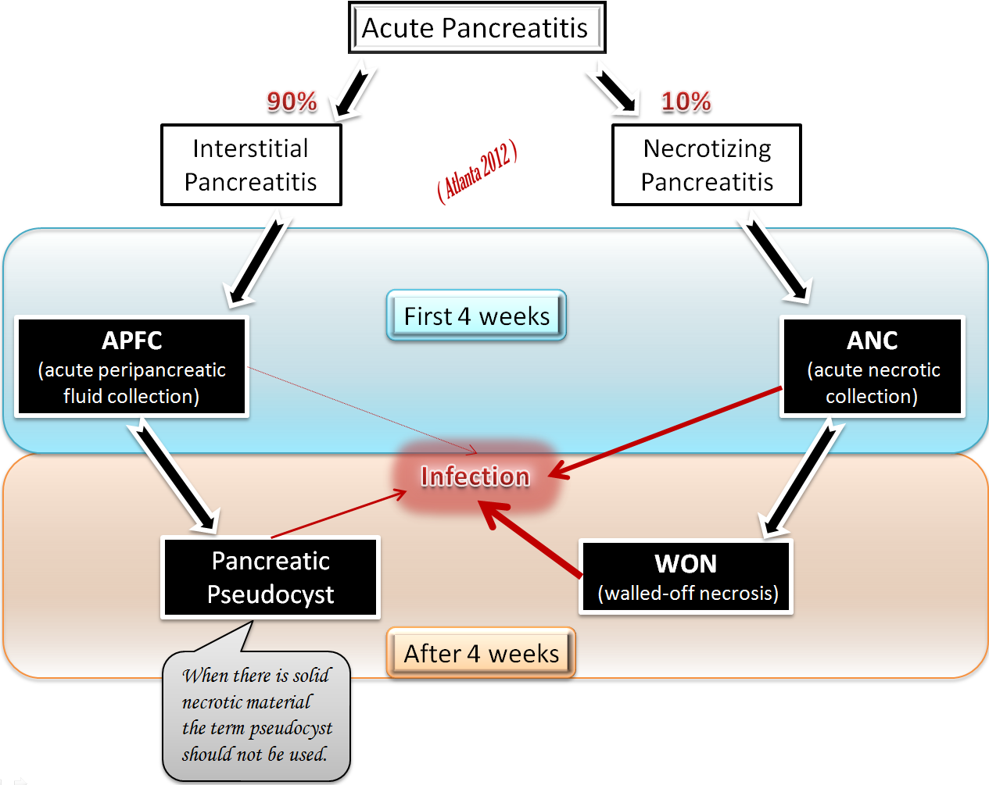

Slide 14
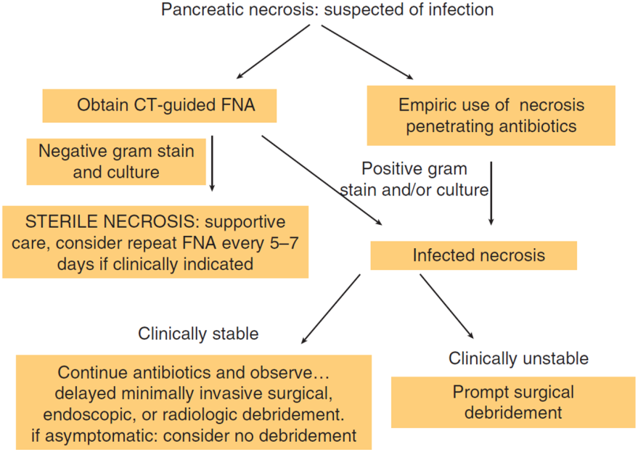

Slide 16
65 year old man present to the clinic with complain of jaundice. He has no weight loss and no abdominal pain.
The lab result : ALP of 270 and bilirubin of 73. IgG-4 levels are >3 ULN
CT abdomen reveal a diffuse enlargement of the pancreas with loss of definition of pancreatic clefts "sausage-like appearance", with evidence of retroperitoneal fibrosis.
The next step in the management is
Start chemotherapy with Gemcitabine
EUS guided biopsy of the pancreas
Pancreaticoduodenectomy (Whipple procedure)
Start Prednisolone 40mg OD

Slide 17
Prominent lymphocyte infiltration with associated fibrosis of the pancreas that causes organ dysfunction.
More common in men, with age > 50
The most common presentation is painless JAUNDICE
Commonly patients are sent for evaluation after being found to have a mass, or fullness in the pancreas and there is a suspicion of pancreatic cancer
Associated features may include; sclerosing cholangitis retroperitoneal fibrosis, fibrosis of the salivary glands, bile ducts and kidneys.
Two types exist of AIP
Type I | Type II
Elevated Serum IgG4 Systemic disease 85% are men Relapse in 50% Require long term immunosuppression | Normal serum IgG4 Pancrease specific 20-30% with concurrent IBD Young patient Doesn’t relapse

Slide 18
Which is true in regard to chronic pancreatitis
Smoking is not a precipitating factor
No easy laboratory test is available to diagnose Chronic pancreatitis
Surgery is never a treatment option
Chronic pancreatitis is not a risk factor for pancreatic cancer
Steatorrhea occurs early in the course of the disease

Slide 19
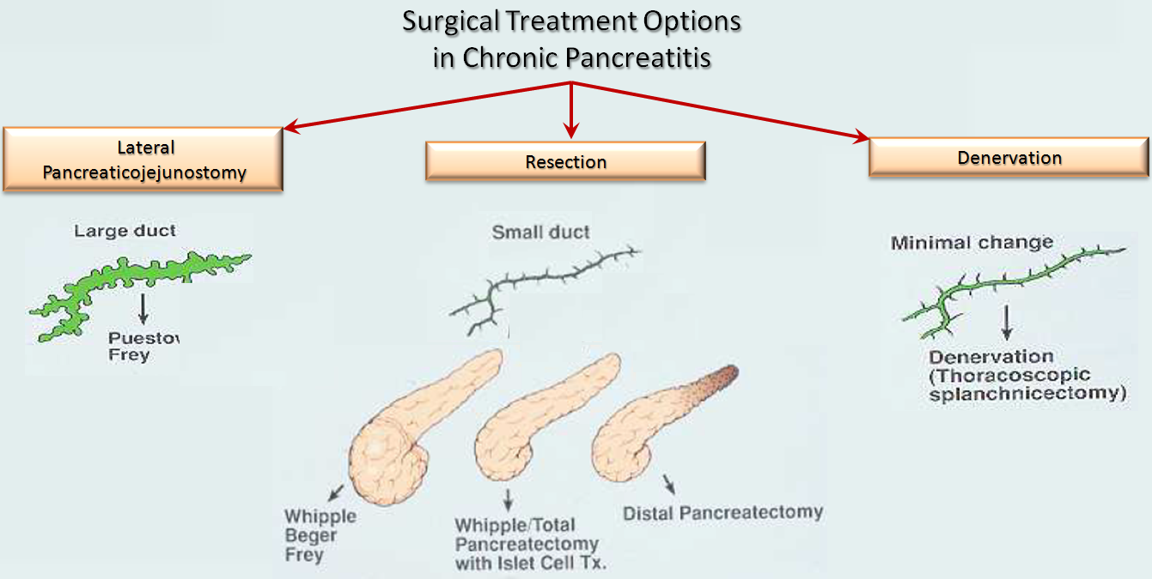
The pancreas has great functional reserve (example, 90% of the pancreas has to be destroyed before steatorrhea occurs.)
Invasive tests of pancreatic function (eg, the “tubed” secretin test) can demonstrate functional derangements even in the absence of steatorrhea

Slide 20
19 year old lady is visiting you in the clinic for the first time. She was diagnosed with isolated ileal Crohn’s disease 6 years ago. She is now doing well on Azathioprine. She is not a smoker.
What do you tell her in regard to prognosis
The risk of complication is higher as she never smoked
The risk of complication is increased because she was diagnosed at a young age.
She has a risk of increased colon cancer
The risk of complication is higher as she is female

Slide 21
The Montreal classification of Crohn’s Disease
Age at diagnosis | Location | Behaviour
A1 below 16 y | L1 ileal | B1 non‐stricturing, non‐penetrating
A2 between 17 and 40 y | L2 colonic | B2 stricturing
A3 above 40 y | L3 ileocolonic | B3 penetrating
 | L4 isolated upper disease | P perianal disease
indicate modifiers that are added to other classes e.g: Location L2+L4 , Behavior B2 + P
Predictors of poor prognosis in Crohns disease
A1 L3 B2 & 3 P | Deep ulcerations Requiring Steroid for the first attack +ve ASCA

Slide 22
Patient was labeled as Ulcerative colitis in another hospital recently. She came to you for a second opinion as her brother was recently diagnosed with Crohn’s disease
What is true in regard to the difference between Crohns and Ulcerative colitis
p-ANCA is more common with Crohn’s disease while ASCA is more with U.C
The rectum is involved in more than 99% of the patients with Crohn’s disease
Presence of perianal abscess favors the diagnosis of Ulcerative colitis
In up to 15 %, the differentiation of U.C and Crohn’s can not be made
Presence of inflammation of the whole colon with minor/moderate inflammation in the terminal ileum is pathognomonic for Crohn’s disease

Slide 24
A patient with known Crohn’s disease has been maintained on 5-ASA. The patient is losing weight and has diarrhea. CT abdomen shows evidence of active ileal disease with entero-enteric fistula. The patient will be started on Infliximab.
Which is true ?
Anti-TNF should always be restricted for evidence of fistulising disease.
Azathioprine has a benefit when combined with Infliximab in term of response
Infliximab should never be used in patient’s with isolated Anti-Core for HBV
All Anti-TNFs are received as Intravenous injections.
Entero-vaginal and entero-vesical fistulas have an excellent response to Anti-TNF compared with perianal fistulas

Slide 25
 | Infliximab | Adalimumab | Certolizumab pegol | Golimumab
Induction | 5mg/ kg @ IV 0,2,6 weeks | 160mg D1 80mg D15 s/c | 400mg @ 0,2,4 weeks s/c | 200 mg s/c @ week 0 100 mg @Week 2
Maintenance | 5mg/kg every 8 weeks | 40 mg every 2 weeks | 400mg every 4 weeks | 100mg every 4 weeks
Intensification | Up to 10m/kg g every 6 weeks | 80mg every 2 weeks Or 40 mg every week | ? | ?
Antibodies | ATI | Human Antihuman Antibodies (HAHAs) immeasurable commercially |  | Ulcerative colitis ONLY
Antibodies incidence | 13% | 2.6% | 10%

Slide 26
Week 26 | Week 50

Slide 27
Which is true of the extra-intestinal manifestations of Ulcerative colitis and Crohn’s disease ?
Patients with isolated ileal Crohn’s disease have an increased risk of Primary Sclerosing Cholangitis
Uvietis is considered a mild and self limiting complication is the setting of IBD
Pyoderma gangrenosum correlate well with the disease activity
Patients presenting with acute flare of U.C with frequent PR bleeding will require prophylactic anticoagulation as the VTE risk is high.
Ankylosing spondylitis is the most articular complication of IBD.

Slide 28
( ECCO 2012 ) | Incidence | Description | Activity with colitis
Oral aphthous ulcers. | 10% |  | =
Erythema nodosum | 4.2–7.5% ( More with CD ) | May also be drug reaction to the sulfapyridine | =
Pyoderma gangrenosum | 1% to 2% | a sterile abscess with neutrophilic infiltration. Avoid biopsy as pathergy effect may occur. Usually respond to intralesional glucocorticoid, | ≠
Episcleritis | 5% to 8% | painless hyperemia of the sclera and conjunctiva without loss of vision | =
Uveitis |  | painful eye with visual blurring photophobia and headache are common | ≠
Isolated sacroiliitis | 10% - 15% |  | ≠
Ankylosing spondylitis | 1% to 2% |  | ≠
PSC | 3% | Ursodeoxycholic acid can slow the progression. | ≠
Hypercoagulability |  | VTE is the most common Renal artery, mesenteric, portal, hepatic and cerebral thrombi | =

Slide 29
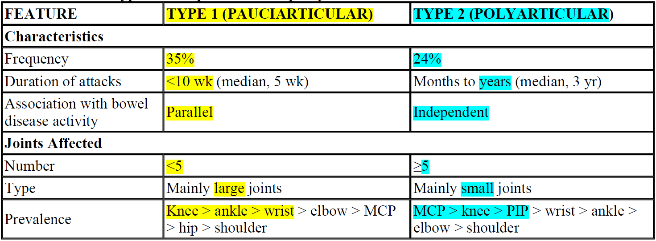

Slide 30
Patient with Ulcerative colitis, diagnosed 6 years ago and maintained on Pentasa 3 g per day. He present to the emergency room with 7 stools/day with blood.
Temp 38.8 HR 110 Hgb of 9.5 and ESR of 130. The patient has a septic screen, and started on Prednisolone 60mg per day.
After 3 days, his condition remain the same, cultures are negative, as well as C.Diff, CT abdomen show no evidence to mega-colon.
The best approach will be:
Urgent sigmoidoscopy
Add Azathioprine
Start Pulse Steroids at Methylprednisolone 1 gram per day
Request CMV IgM
Total Colectomy

Slide 31

2012 Guidelines
In patients with acute steroid-resistant colitis, CMV should be excluded, preferably by tissue PCR or immunohistochemistry, before increasing immunomodulator therapy
IgM for CMV results do not correlate well with CMV colitis

Slide 32
Patients with Crohn’s disease is maintained on Azathioprine and Pentasa. However, the patent is not well controlled as he complain of weight loss and diarrhea. Endoscopy show evidence of active moderate to severe active disease in the ileum. With no strictures of fistulas. Patient underwent extensive biopsies for Tuberculosis that were negative and IGRAs were negative. Infliximab is started at 5 mg/kg at 0, 2 and 6 weeks.
After 8 weeks, the patient is reporting no significant improvement in the symptoms. Colonoscopy is repeated and the results are basically the same. Infliximab levels are checked and found to be high, and the antibodies to Infliximab are negative.
The best course of action is
Switch Infliximab to another Anti-TNF ( Adalimumab)
Surgical resection of the diseased part
Start Anti-Tuberculous treatment
Switch to a Biologic with a different mechanism of action ( Vedolizumab )
Double the dose of Infliximab and decrease the interval of the dosing.

Slide 34
65 ear old patient with dilated cardiomyopathy, atrial fibrillation, diabetes, HTN and chronic constipation, he present to the ER with acute severe abdominal pain, he denies and blood per rectum and did not pass stool today.
On examination, he has normal blood pressure with no fever, but with tachycardia. he has unremarkable abdominal examination.
CT abdomen with oral contrast shows some stool in the colon and U/S abdomen is unremarkable
Patient is screaming of pain.
The best approach is :
Give fleet enema and book Colnoscopy the next day
Start PPI and request an urgent Gastroscopy
Repeat CT abdomen with CTA protocol
Psychological referral
MRCP to R/O gallstones

Slide 35
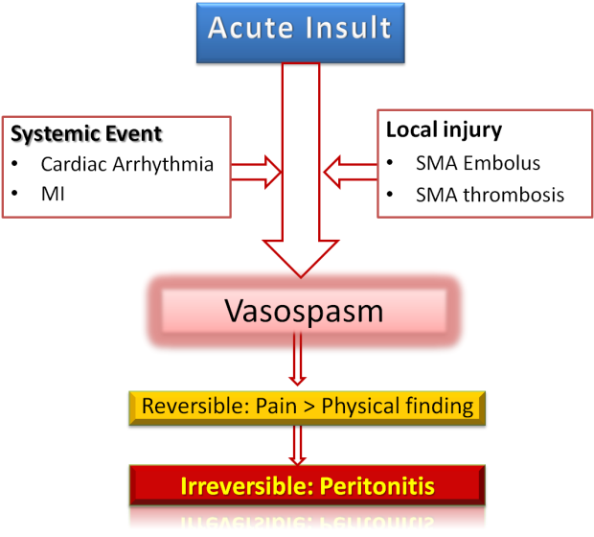

Slide 36
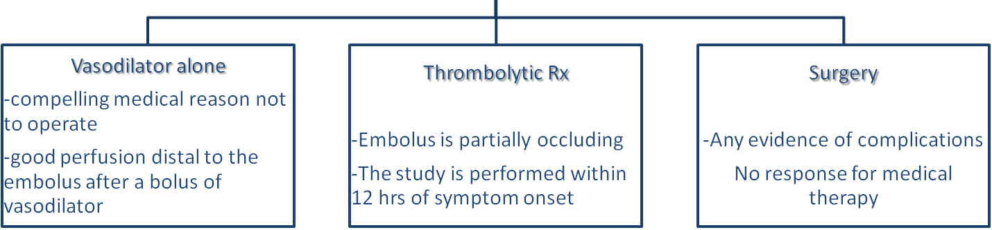
Management
Do not use vasopressors
Do not do angiography with vasodilatation in the presence of hypotension or hypovolemia (otherwise profound hypotension and death)
intra-arterial papaverine before and for 24 hours after embolectomy 30-60 mg/hr

Slide 37
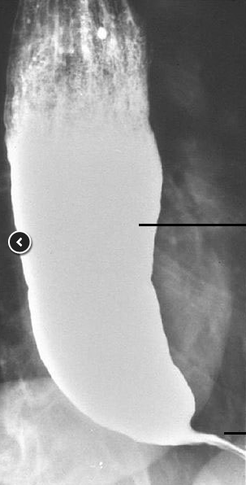
69 year old man present with a recent history of dysphagia to solids but no liquids.
The patient has no problem in initiating swallowing, but has problem with regurgitation of old food that he swallowed. The patient also report weight loss of 10 kg over the last 3 months. He underwent barium swallow as shown.
What is the next step in management :
I. Refer the patient to Surgical Myotomy
II. Start Nifedipine 10-30mg, 30-45min before meal
III. Endoscopy, preferably with endoscopic ultrasound.
IV. Referral to Gastrostomy tube via interventional radiology
V. Reassurance

Slide 38
Achalasia “failure to relax.”
Achalasia results from a decreased number of nonadrenergic, noncholinergic inhibitory ganglion cells. The cause of achalasia is unknow.
Barium swallow with fluoroscopy is an excellent for screening, but manometry is still required in all patients. Endoscopic evaluation is recommended to exclude the presence of pseudoachalasia
Squamous cell carcinoma risk is increased in achalasia

Slide 39
Causes of Pseudoachalasia include
Malignancy especially Gastric Ca
Paraneoplastic with Lung Ca
Chagas Disease
Amyloidosis,
Sarcoidosis
Postvagotomy

Slide 40
Patient with cirrhosis and early decompensation features from HCV/NASH. He is post-SVR with CHILD-B 7 points. Which is true in regard to his medications
Patient is at higher chance of drug induced liver injury in general
Statins are safe and might be of benefit in general.
There is no safe dose of paracetamol in decompensated cirrhosis
NSAIDs at small doses are generally safe if taken with PPI
PPI has a positive impact on survival in patients with Cirrhosis

Slide 41
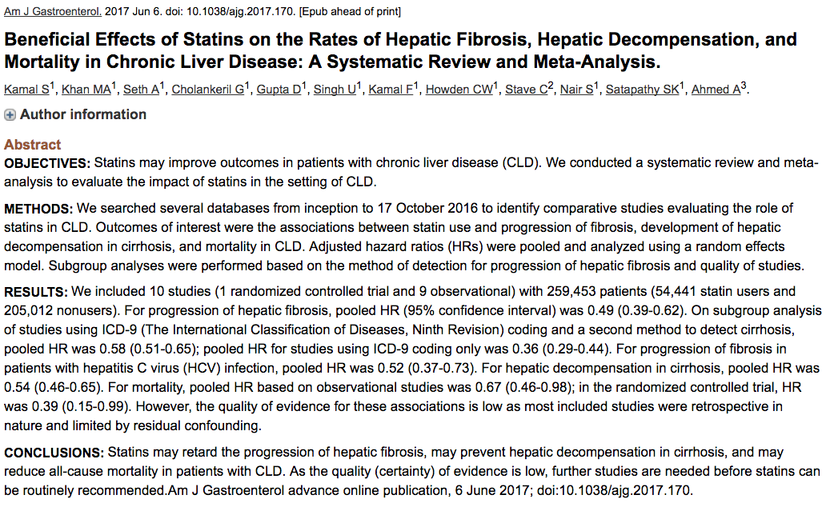

Slide 42
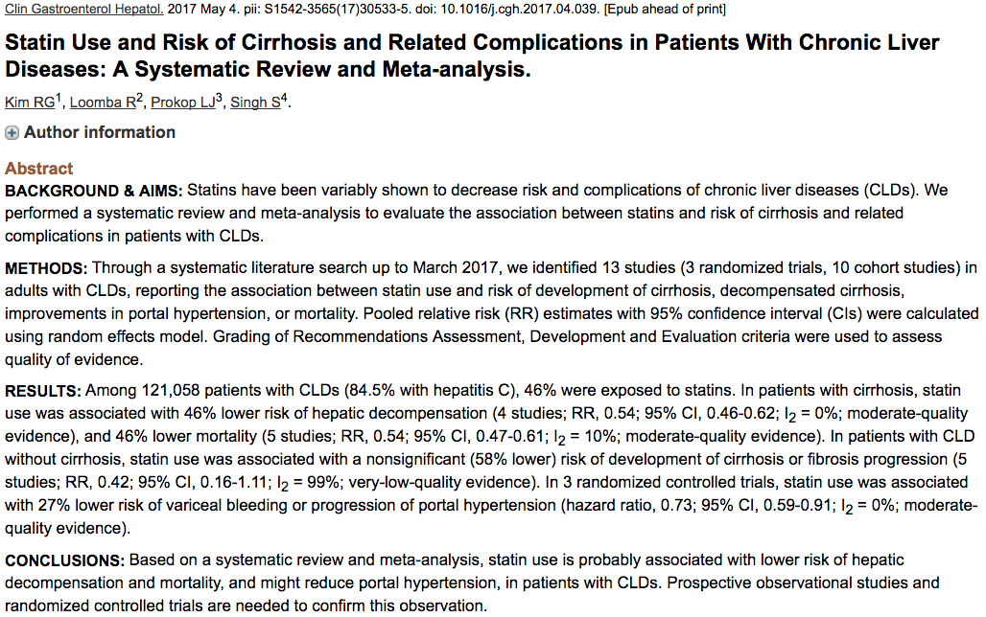

Slide 43
In regard to hemostasis with cirrhosis, all are true Except
INR does no reflect the true hemostasis in cirrhosis
vWF levels are increased in cirrhosis
Oral thrombopoietin-receptor agonist (Eltrombopag ) is an excellent choice for thromboctyopenia with no significant side effects
TIPS should not be used as a treatment strategy for thrombocytopenia

Slide 44
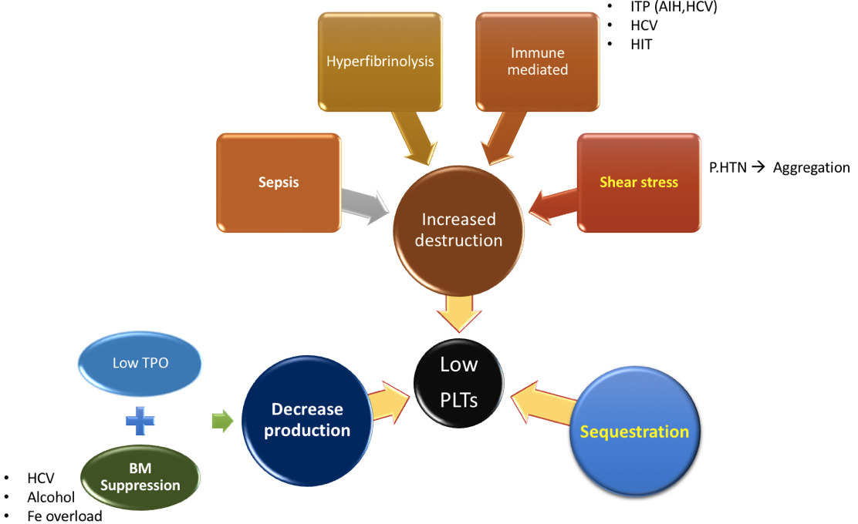

Slide 45
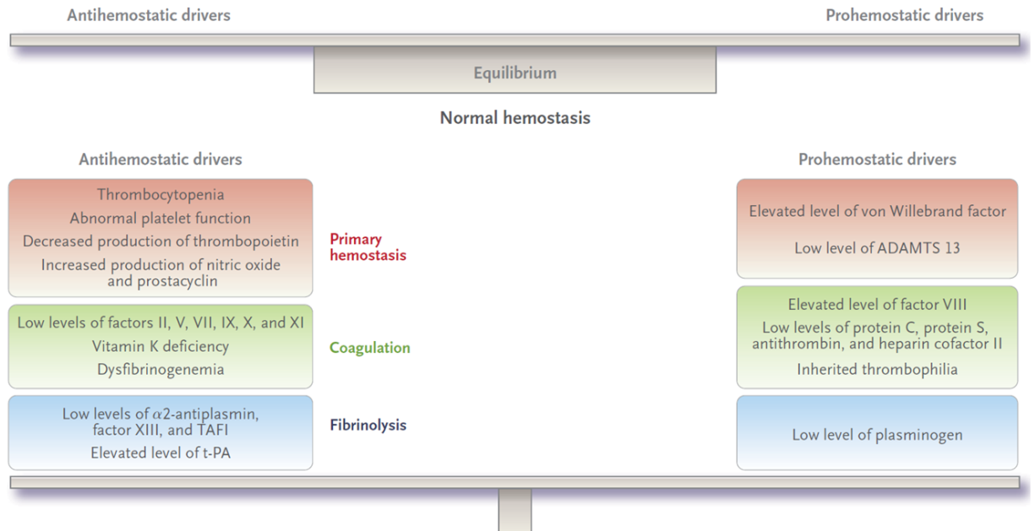

Slide 46
As per AASLD for patients with SBP, all are true Except
Uncomplicated SBP may be treated effectively in an outpatient setting with oral ofloxacin 8-10 days
Paracentesis after 48hrs for patients who do not show clinical improvement is indicated.
Prophylaxis is always recommended after the 1st SBP. But primary prophylaxis should not be considered
Only patients with elevated creatinine and jaundice should receive Albumin to prevent HRS

Slide 47
Complicated SBP, where oral AABx are not an option
Vomiting Shock | Grade II (or higher) H.E Creatinine > 265 mmol/l

Slide 48
Primary Prophylaxis using norfloxacin (or trimethoprim/sulfamethasoxazole) is indicated when (AASLD 2013)
Ascitic fluid protein <1.5 g/dL | And at least one of | serum creatinine >1.2 mg/dL, blood urea nitrogen >25 mg/dL, serum sodium <130 mEq/L Child-Pugh >9 points with bilirubin >3 mg/dL.

Slide 49
62 year old with PBC, She has compensated cirrhosis. Currently complaining of intense pruritis. In regard to moderate to severe cholestasis associated pruritis, which is true
Antihistamine is an effective treatment option
Ursodeoxycollic acid is not associated with worsening pruritis
Rifampin is effective option with no significant safety issue
Cholestyramine ideal dose is 4 gram 2-4 times a day

Slide 50
Treatment of pruritus with PBC (URSO may increase it and it is NOT a treatment )
Anti-histamines
Cholestyramine (4 g per dose to a maximum of 16 g/day given 2-4 hours before or after UDCA)
Rifampicin 150-300 mg twice daily
Phenobarbital
UV light
Naltrexone 50 mg daily
Sertraline (75-100 mg daily)

Slide 51
42 year old lady presents with fatigue. She denies any herbal therapy or high risk for viral hepatitis/ Exam is unremarkable except for shifting dullness
LAB: ALT 180 AST 190 T.Bili 42 INR: 1.6 Albumin 29 ANA:1/640 ASMA: 1/320 IgG >4 ULN, normal IgA and IgM, -ve AMA and viral serologies
Liver biopsy; cirrhosis with active inflammation, piecemeal necrosis and plasma infiltration
What is the best option
This patient is not candidate for therapy as she is cirrhotic
Budesonide at 3mg TID is a good option for induction
Azathioprine and low dose Prednisone is the best first line therapy
HCC risk in AIH relatively rare in AIH cirrhosis, but screening is indicated

Slide 52
Even in advanced fibrosis and cirrhosis substantial regression of scarring after successful treatment has been reported.
In view of the progressive nature of AIH and the effectiveness of immunosuppressive therapy, the consensus group recommends that all patients with active disease should receive treatment
Treatment may be withheld in only rare circumstances, most specifically in the context of burnt out cirrhosis without inflammatory activity
EASL Guidelines

Slide 53
A patient is referred to you from another hospital. He was labeled as NASH cirrhosis with decompensation (ascites and 1x variceal bleeding). He reports a long history of inactive HBV, never treated before.
Upon review of the recent and old labs, you found the following
ALT: 34 AST 41 T.Bili 40 INR 1.8 HBsAg +ve HBeAg –ve
HBV DNA –ve (persistently negative for the last 10 years)
The best approach
Start Tenofovir or Entecavir for HBV immediately
Close monitoring, and if DNA becomes detectable, start therapy with NUCs
Start therapy if DNA > 2000 IU/ml
Inteferon is a good option

Slide 54
The AASLD suggests that adults with compensated cirrhosis and low levels of viremia (<2,000 IU/ mL) be treated with antiviral therapy to reduce the risk of decompensation, regardless of ALT level
The AASLD recommends that HBsAg-positive adults with decompensated cirrhosis be treated with antiviral therapy indefinitely regardless of HBV DNA level, HBeAg status, or ALT level to decrease risk of worsening liver-related complications
Interferon is contraindicated in decompensated cirrhosis

Slide 55
All of the following are true in regard to epidemiology of HCV in Saudi Arabia and in general EXCEPT
The estimated prevalence is 0.7%
After Genotype 4, Genotype 2 is the 2nd most common genotype
The longer the period a patient remain dialysis dependent the higher risk for HCV transmission
Hepatitis C remain the most common cause for liver transplant in Saudi Arabia

Slide 57
In regard to HBV and pregnancy, which is false
  Breastfeeding is safe on medication
  Tenofovir is category B, Entecavir is C
  Check viral load in 2nd trimester, treat if > 200,000
  Treat for a minimum of 1 year post delivery
  C-section is not indicated

Slide 58

If NA therapy is given as prophylaxis, i.e., only for the prevention of perinatal transmission, its duration is not well defined (stopping at delivery or within the first 3 months after delivery).
In pregnant women already on NA therapy, TDF should be continued while ETV or other NA should be switched to TDF (Evidence level II-2, grade of recommendation 1).

Slide 59
A 25 year man is evaluated for HBV, he is an IVDU. And was never treated for HBV Labs: ALT: 178, normal functions and HBV PCR is 150 IU/ml. Anti HDV is +ve
Which is true in regard to HDV-HBV
Coinfection has increase rate of severe fulminant hepatitis
Superinfection has a high rate of spontaneous clearance.
Ribavirin monotherapy is indicated for HDV when HBV doesn’t’t require treatment
Presence of +ve HDAg is a must to label a patient with chronic infection.

Slide 60
Screening is best achieved by screening for total anti-HDV antibody.
In chronic HDV infection, anti-HDV is present in high titers. Thus, HDAg cannot be detected by assays since it is complexed with anti-HDV.
This will be confirmed by immunohistochemical staining for HDAg in liver tissues.
Measurement of serum HDV RNA should be performed in patients who are anti-HDV positive but have no detectable HDAg in the liver

